Slide 1
Remembering Empire Les Pieds tanqués
Session 6

Slide 2
Les pieds tanqués (2012)
This session:
Introduction to the play and context
What is pétanque?
Close analyses of sections from pages 1-6 from the printable version/ sections 0 and 1 from the online version of the play
Discussion of key scenes and groupwork
What are the fiche de lecture and Character profiles?

Slide 3
Les pieds tanqués (2012)
From the introduction:
‘En Provence, sur un terrain de boules, quatre joueurs jouent à la pétanque: Zé, le pied-noir ; Yaya, le Français né de parents algériens ; Loule, le Provençal « de souche » ; et Monsieur Blanc, le Parisien fraîchement arrivé dans la région.'
Can you identify and explain where each character is from based on this description?
What might you expect their feelings towards the Algerian War of Independence to be?​
What is the setting of the play?

Slide 4
Les pieds tanqués (2012)
From the promotional materials for the play:
Dans cette pièce, ce n'est pas une simple partie de pétanque entre amis. On fait face à toutes les souffrances de la guerre d’Algérie et les questions d’identité. Pendant le jeu, le passé ressurgit et on découvre les blessures secrètes de chacun et leur lien avec cette guerre sur le terrain de pétanque qui les rassemble et les unit…
Dans cette comédie dramatique, les mémoires s’entrechoquent.
What themes do you expect in this play? Use the words in bold to help you, noting any new vocabulary.

Slide 5
La bande annonce
Watch the trailer (bande annonce) for the play, Les Pieds tanqués :
https://youtu.be/5Mo5JClm1yA
You will notice that the entire play centres around a game of pétanque.

Slide 6
La pétanque
What is pétanque?
A traditional game, related to lawn bowls, in which players aim to throw, toss, or roll their metal balls as close to a small ball, or jack, as possible. Any balls that finish closer to the jack than the other players’ balls gain points. It is usually played on hard ground in public spaces or on dedicated boulodromes.
What is its cultural significance?
Pétanque has long been a leisure activity in France and is widely played across France’s former colonies and territories. As a game requiring only inexpensive equipment and using public space, it is popular and accessible to all. The sport is typically played by men but is open to anyone from any background, including those who will have experienced the game outside of Provence where it remains a culturally important meeting point.

Slide 7
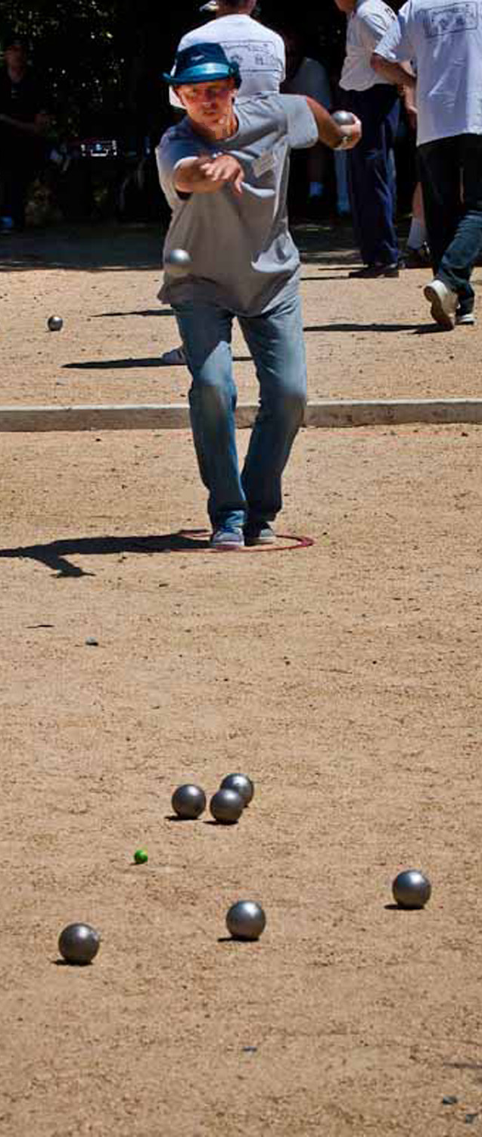
La pétanque
The name pétanque
The game’s name comes from petanca in the Provençal dialect, from the expression pè tancat [ˈpɛ taŋˈkat], meaning 'foot fixed' or 'foot planted' (on the ground), and could be translated into French as pieds tanqués.
As we read, think about why the play would take this name for its title.
How do you play? Watch this video for Pétanque Rules
Further information: https://www.pieds-noirs.stir.ac.uk/introduction-les-pieds-tanques/

Slide 8
Excerpt Focus: Opening radio scene
Focus: page 2 /section 0
Read: the paragraph that begins 'Loule entre sur le terrain'. ​
Loule, the Provençal arrives to play pétanque and turns on the radio:​
‘En faisant défiler les ondes radiophoniques, on annonce qu’une bombe vient d’exploser à la station du métro Saint-Michel à Paris. Nous sommes, en effet, le 24 juillet 1995 et le Président Chirac doit se rendre d’un instant à l’autre sur les lieux du drame. Il écoute un bref moment l’information puis passe sur une autre station’​
Watch: Video link here [00:20-02:45]

Slide 9
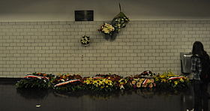
Opening radio scene
What is the context of the event on the radio?​
L'attentat du RER B à Saint-Michel en 1995​
A bomb explosion in Saint-Michel station on the Line B of the RER train in Paris. ​
The Algerian Groupe islamique armé (GIA) claimed responsibility.​
There were 8 deaths and 117 injured.​
This was part of a wave of attacks in France in 1995 that were linked to Islamic extremism and France’s approach to Algeria.​
The attack reflected tensions from France’s secularist and assimilationist policies against Algeria’s Islamic status and their memories of colonial oppression.​
Discuss: Why do you think Loule turns off the radio and its coverage of this event?

Slide 10
Opening radio scene
Why would Loule turn off the radio?​
There is a sense of the past returning as the memories of the Algerian War of Independence and related tensions between France and Algeria seep back into the present. ​
We witness Loule’s desire to ignore this event and the memories that it triggers.​
Marseille, and Provence more generally, was the destination of many pieds-noirs returning from Algeria after the Algerian War of Independence. Later, it was the destination for Algerian immigrants seeking work and a new life for their family.​
As a local Provencal Frenchman, Loule has had enough of French-Algerian conflict and resents the resultant waves of immigration into Provence. ​

Slide 11
Excerpt focus: La mémoire courte
Read: pp. 2-3/ section 0 until 'la belle époque!'​
On these pages, we hear some pétanque terminology and game talk as we meet several of the characters.
Zé (pied-noir) and Yaya (Algerian heritage) arrive – why is this group interesting?
Zé insists that he can beat Loule and Yaya alone – how do the characters speak to each other at this point in the play?

Slide 12
Excerpt focus: La mémoire courte
Focus: excerpt from page 3 / section 0
Loule (à Zé) – Il a raison t’as la mémoire courte.
Zé – La mémoire courte ? Ah non, pas moi.
Yaya (s’entraînant à tirer) – C’est la Fanny ! Ça le rend amnésique. Il a la mémoire qui sélectionne
How does this conversation and idea of ‘short memory’ link into the greater historical context that the play refers to?​

Slide 13
La mémoire courte
Zé: La mémoire courte ? Ah non, pas moi.
Yaya: Il [Zé] a la mémoire qui sélectionne
The pieds-noirs are typically represented as refusing to let go of a memory of the past which defines them, one that focuses on their victimhood, which is contested by other accounts. ​
This scene plays with that reputation, as Zé highlights that he doesn’t have a short memory, and Yaya responds that he has a selective memory instead.
This line about Zé having a short memory is ironic as he is a pied-noir, part of a group known for their attachment to a certain, selective version of the past.

Slide 14
Excerpt Focus: Parfaitement intégré
Focus: excerpt from page 3/ section 0:
Zé – Toi, je te désélectionnerais bien volontiers. (S’approchant de Loule) Allez, envoie quatre boules que je vous désintègre*.​
Yaya – Pas moi Zé. Je suis parfaitement intégré !​
*désintègre is a play on words. Zé is referring to knocking Yaya’s boules apart [‘disintegrating’ them in literal terms] in the game, but Yaya answers by referring to how ‘integrated into society’ he is. ​
The characters shift from talking about the boules to talking about their own identities.​
Discuss: With this in mind, why is it significant that Yaya would make the statement 'Je suis parfaitement intégré !'? Think about his background as you discuss.

Slide 15
Excerpt Focus: Parfaitement intégré
Focus: Page 3/ section 0 excerpt: Yaya: moi je suis parfaitement intégré
Integration refers to the process expected of immigrants who arrive in a new country. They are expected to learn and adapt to the culture of their new country. As an idea it does not make much sense to expect people born and brought up in France to 'integrate' into it, because they have never lived anywhere else.
Yaya was born in France and has French citizenship, but he has Algerian heritage because his parents were Algerian.
Because of France's colonial past and the experience of the Algerian War, some white French people do not accept that people of Algerian origin are 'properly French', even if they have been born in France.
This raises questions of integration of immigrants into secular and assimilationist France.

Slide 16
Group study: The arrival of Monsieur blanc
Read: p. 4/ section 1 - the arrival of Monsieur Blanc
Un homme élégant, chapeau et tout de blanc vêtu, s’est avancé de l’autre côté du terrain. Les autres l’ont remarqué et se regardent un brin moqueur. L’homme les observe jouer un moment.
If you would like to watch the scene: Video link here [06:45-08:45]
Read pages 4-6/ sections 0-1 – if there are several of you, you can each choose a page and summarise it for the others.
How is Monsieur Blanc treated by each of the others on these pages? Why do you think this is?

Slide 17
Group study: The arrival of Monsieur blanc
Read: page 4/ section 1: M. Blanc is well-dressed and is clearly new to the area. He observes before approaching.
The characters mock M. Blanc to each other: Yaya (en aparté vers Loule) – Tè Loule, la voilà ton aventure.
Loule offers M. Blanc some boules to play with them, but M Blanc has a brand-new unused set, which makes him a further target for ridicule.
He provides his full title, M. Blanc de la Martinière, which is an indicator of his upper-class background, and another reason for the characters to mock him. He mentions that he is building a new house for himself.
Read: page 5/ section 1: They begin to play, and continue to mock M. Blanc for using the incorrect words for the game in this region. He plays poorly.

Slide 18
Excerpt focus: obligé?
Loule – Alors, comme ça vous venez d’arriver dans la région ?
Monsieur Blanc – Comme vous voyez…
Loule – On n’est pas bien ici ?
Monsieur Blanc – Oui… Mais c’n’est pas donné.
Zé (agacé) – Pourquoi, on vous y a obligé ?
Monsieur Blanc – Obligé ?
Zé – À venir ici.
Monsieur Blanc – Non, pourquoi ?
Yaya – Un jour quelqu’un est rentré chez lui et l’a sommé de déguerpir. Depuis il s’en remet pas.
Monsieur Blanc esquisse un sourire un peu gêné.
Focus: excerpt from page 5/ section 1
What are Zé and Yaya referring to here? Why is Zé 'agacé'?
Why would M Blanc feel ‘gêné’?

Slide 19
Excerpt focus: obligé?
Focus: excerpt from page 5 / section 1
What are Zé and Yaya referring to here? Why is Zé agacé?
They are referring to the fact that at the end of the Algerian War of Independence, the pieds-noirs, including Zé, had to flee from Algeria to France for refuge.
Why would M Blanc feel ‘gêné’?
M Blanc is often quite naïve. He doesn’t understand what is being referred to at first here. He has come to Provence to buy land and build a new home, and has implied that this has been challenging. However, in comparison with Zé’s forced move to Provence, he is in a very privileged position, which they are trying to make him aware of.

Slide 20
Excerpt Focus: je suis d’ici !
Yaya – Vous en avez, vous, de la chance Monsieur Blanc. Figurez-vous qu’à moi, on me demande jamais (avec un ton mielleux) : « Alors comme ça, vous venez d’arriver dans la région ? »
Monsieur Blanc (mal à l’aise et n’ayant toujours pas joué) – Je comprends très bien ce que vous ressentez… Quand on n’est pas d’ici parfois on vous le fait bien comprendre…
Yaya (vexé) – Oh, oh, attendez Monsieur Blanc, moi je suis d’ici ! Il est pas beau lui… (accentuant son accent du Midi) ça s’entend pas que je suis d’ici ?
Zé – Ça s’entend, mais ça se voit pas.
Focus: excerpt from page 6 / section 1
Why is Yaya annoyed at M Blanc?

Slide 21
Excerpt Focus: je suis d’ici !
Yaya – Vous en avez, vous, de la chance Monsieur Blanc. Figurez-vous qu’à moi, on me demande jamais (avec un ton mielleux) : « Alors comme ça, vous venez d’arriver dans la région ? »
Monsieur Blanc (mal à l’aise et n’ayant toujours pas joué) – Je comprends très bien ce que vous ressentez… Quand on n’est pas d’ici parfois on vous le fait bien comprendre…
Yaya (vexé) – Oh, oh, attendez Monsieur Blanc, moi je suis d’ici ! Il est pas beau lui… (accentuant son accent du Midi) ça s’entend pas que je suis d’ici ?
Zé – Ça s’entend, mais ça se voit pas.
Focus: excerpt from page 6 / section 1
Why is Yaya annoyed at M Blanc?
M Blanc has implied that Yaya is not ‘d’ici’. However, Yaya has lived his entire life in France. Yaya’s appearance suggests his Algerian heritage and M Blanc’s question implies that he sees him as a foreigner.

Slide 22
The arrival of Monsieur blanc
If you would like to watch the scene: Video link here [06:45-08:45]

Slide 23
Fiche de lecture
Each week, we will update two documents
a fiche de lecture (reading guide) on the play
character profiles
Discuss what you can include in these documents with a partner or a group.
If you have time, share your ideas with other groups.
Add your notes from this week.

