Slide 1
Remembering Empire THE LAND BENEATH MY FEET
Session 9

Slide 2
the land beneath my feet
Today’s pages:
Pages 34-42 in the printable version of the play
Themes: Immigration, multiple histories
Online Sections:
8. Yaya’s Algerian family, including Harki uncle (until he's given enough.)
9. Immigration to Provence, France, and Loule’s resentment (until Is that it? Are you done?)

Slide 3
'You need to love france'
Read: p. 34 from 'Ze: You see, Yaya...' until 'A pause.'
Loule questions Yaya’s love for France.
Loule – It takes more than that! You need to love France.
Yaya – Love it? Are you the one dishing out permits?
Monsieur Blanc (to Loule) – We know what happens if you love it too much.
Loule - You say you love it, but who's to say that deep down you don't absolutely despise it?
Yaya – Think whatever you want. I ain’t ever stopped loving it.
Loule – Can you prove it?
Why does Loule ask Yaya to prove his love for France, but not the other characters? Is this fair?

Slide 4
'YOU NEED TO LOVE FRANCE'
Why does Loule ask Yaya to prove his love for France, but not the other characters? Is this fair?
Loule dislikes that Yaya is critical of France and defensive of Algeria. The fact that he is of Algerian parentage also adds to his critique of Yaya, even though Yaya has always lived in France.
Discuss:
Do you agree with Loule that ‘You need to love France’? Does one have to love one’s country?
Does it change things if the person is an immigrant or, as in Yaya’s case, the son of immigrants?

Slide 5
Yaya’s family
Read: p. 35 from 'what a ridiculous question’ until 'A pause'.
We learn about Yaya’s family, including his uncle who was a harki.
Yaya – My dad was in the FLN. The paras arrested him and we never saw him again. My uncle was a harki and he was killed when they stopped him boarding one of the boats...
Zé – A harki?
Yaya – Yeah, my uncle. Just as they were casting off its moorings, the ship's captain got the order to offload all the harkis on-board. He was killed as the real French soldiers
Who were the harkis?
What does this show about the differences that were possible within even just one family?

Slide 6
Yaya’s family
Yaya’s account demonstrates how a Muslim family in Algeria could have different allegiances and suffer because of all of them.
His father was a member of the FLN, supporting independence, who was arrested by French paratroopers and never seen again.
His uncle was a harki, an indigenous Algerian fighting for the French army against the FLN. When independence came, he tried to leave for France with his regiment, but the ship’s captain received orders to disembark all the harkis on board. They were killed under the gaze of their French comrades.

Slide 7
Yaya’s harki uncle
Zé – ‘Ow come you’ve never told me about your uncle?
Yaya – I have told you about him. Lakdhar!
Zé – You never told me he was a harki.
Yaya – It's my mum... She didn't want us to say.
Why would Yaya and his mother have kept this information about his uncle secret?

Slide 8
Yaya’s harki uncle
Why would Yaya and his mother have kept this information about his uncle secret?
Yaya – You know, Zé, to some people, harkis are traitors. But a month before they bumped him off, he was the one who smuggled her out, along with a French officer he knew...One who didn't follow orders. She was about to give birth, she was alone... Ever since she told me that story, it's funny, you know, I’ve always had a soft spot for people who don't follow orders.
The harkis were a group of Algerians who fought in the French army and so were seen as traitors. As a result, their families were often ashamed of them.

Slide 9
State Apologies
Read: p. 37 from 'if justice' to 'he's given enough'
In this sequence, the characters discuss the role of national apologies.
Yaya – If justice was gonna have anything to do with it, the French government would’ve been condemned 40 years ago. Wouldn't recognising the sacrifice of the harkis mean admitting to France's cowardliness?
Loule – We acknowledged our responsibility towards the Jews...
Loule’s allusion here is to World War Two, when the French puppet government led by Marshal Pétain complied with Nazi orders to deport Jews from France to the concentration camps. In 1995 President Jacques Chirac formally recognized France’s responsibility.

Slide 10
forgiveness
Monsieur Blanc – For what it's worth, Yaya, on behalf of my father, for your uncle and your father (he removes his hat and offers him his hand): I ask for your forgiveness.
A pause. Yaya (stepping forward and shaking his hand) – Thank you, Monsieur Blanc, but leave him be, your old man, he’s given enough.
Reminder: Why is M. Blanc in particular asking for forgiveness from Yaya?
In your opinion, are national apologies important? Is it meaningful for a head of state to apologise for the crimes of our ancestors? What about M. Blanc's actions – is it more meaningful for him to apologise on behalf of his father? What does it achieve here?

Slide 11
questioning Identity
Read in groups:
Group 1: p. 38 from 'So why are you banging on...’ to ‘I'd look an idiot in Algeria too...’
What does this scene highlight about Yaya’s status in France compared to the others? Is that fair?
Group 2: p. 39 from ‘So you're Jewish?’ to 'He turns into a figurine, trapped in the past.’
Why is Loule bitter?
Summarise the scene to the other group and respond to the questions

Slide 12
Group 1
What does this scene highlight about Yaya’s status in France compared to the others? Is that fair?
What d’you see when you look at me, Loule? D’you think I can disown my roots?
Yaya is conscious of his skin colour and his difficulty in proving his citizenship due to his origins (his parents were born in Algeria when it was part of France but as Muslim French subjects they were never given identification papers). He highlights how this leads to him being treated differently.
When the day comes that they ask to see my papers, who knows, maybe they’ll send me over there? What a muppet I'd look.
Yaya is less protected than others and now that he has lost his ID card, worries that if he is asked for his ID papers, he may be deported to Algeria, even though he has never lived there.

Slide 13
Group 2
We see Loule’s resentment because of the claims of victimhood made by everyone else and the obligation to share his ‘home’:
Loule – Don't forget that muggins here is the poor sod who’s welcomed you all to his home! (tapping his foot).
Yaya and Zé – His home?
Loule – Yes, his home.
In your opinion, is Loule more ‘home’ than the others? Why / why not?

Slide 14
Loule’s identity
Loule – Yes, his home. The poor sod doesn’t recognise it any more, d’you hear me? He tries to put on a brave face, make himself stand out a little, show that he exists...show that this is still Provence dammit! So he clowns around on café terraces. He speaks too loud. Instead of taking his game of boules seriously, he messes around, gestures wildly. He drinks more Pastis than he probably should! But really, he doesn’t know what he's made of anymore, his culture, his language, his accent, they're all things off the telly or stuff he's got from his ancestors. So he ends up turning into a Marcel Pagnol character! Or worse still, Tartarin of Tarascon, a buffoon...
Loule highlights the clichés that he feels the Provençal people have to fall into in order to keep their culture alive.
Do you agree that some people rely on exaggerated versions of their culture as a means to keep it alive? Do you see equivalents in your culture?
On the next slide, you can view examples of these Provençal clichés:

Slide 15
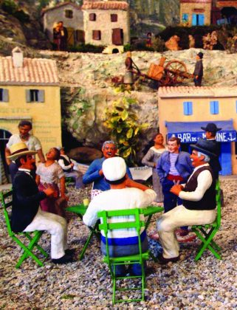
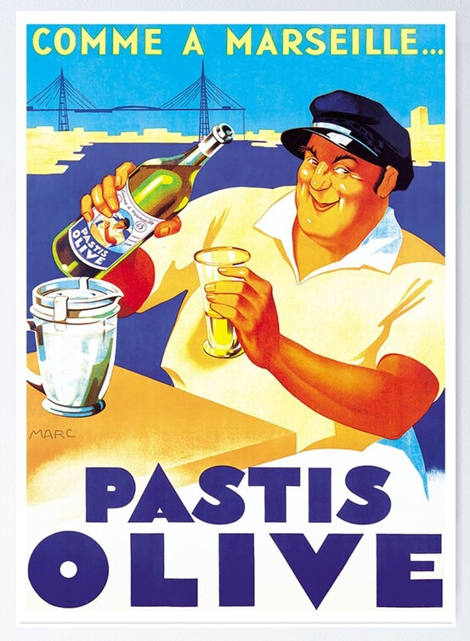
Provençal clichés

Slide 16
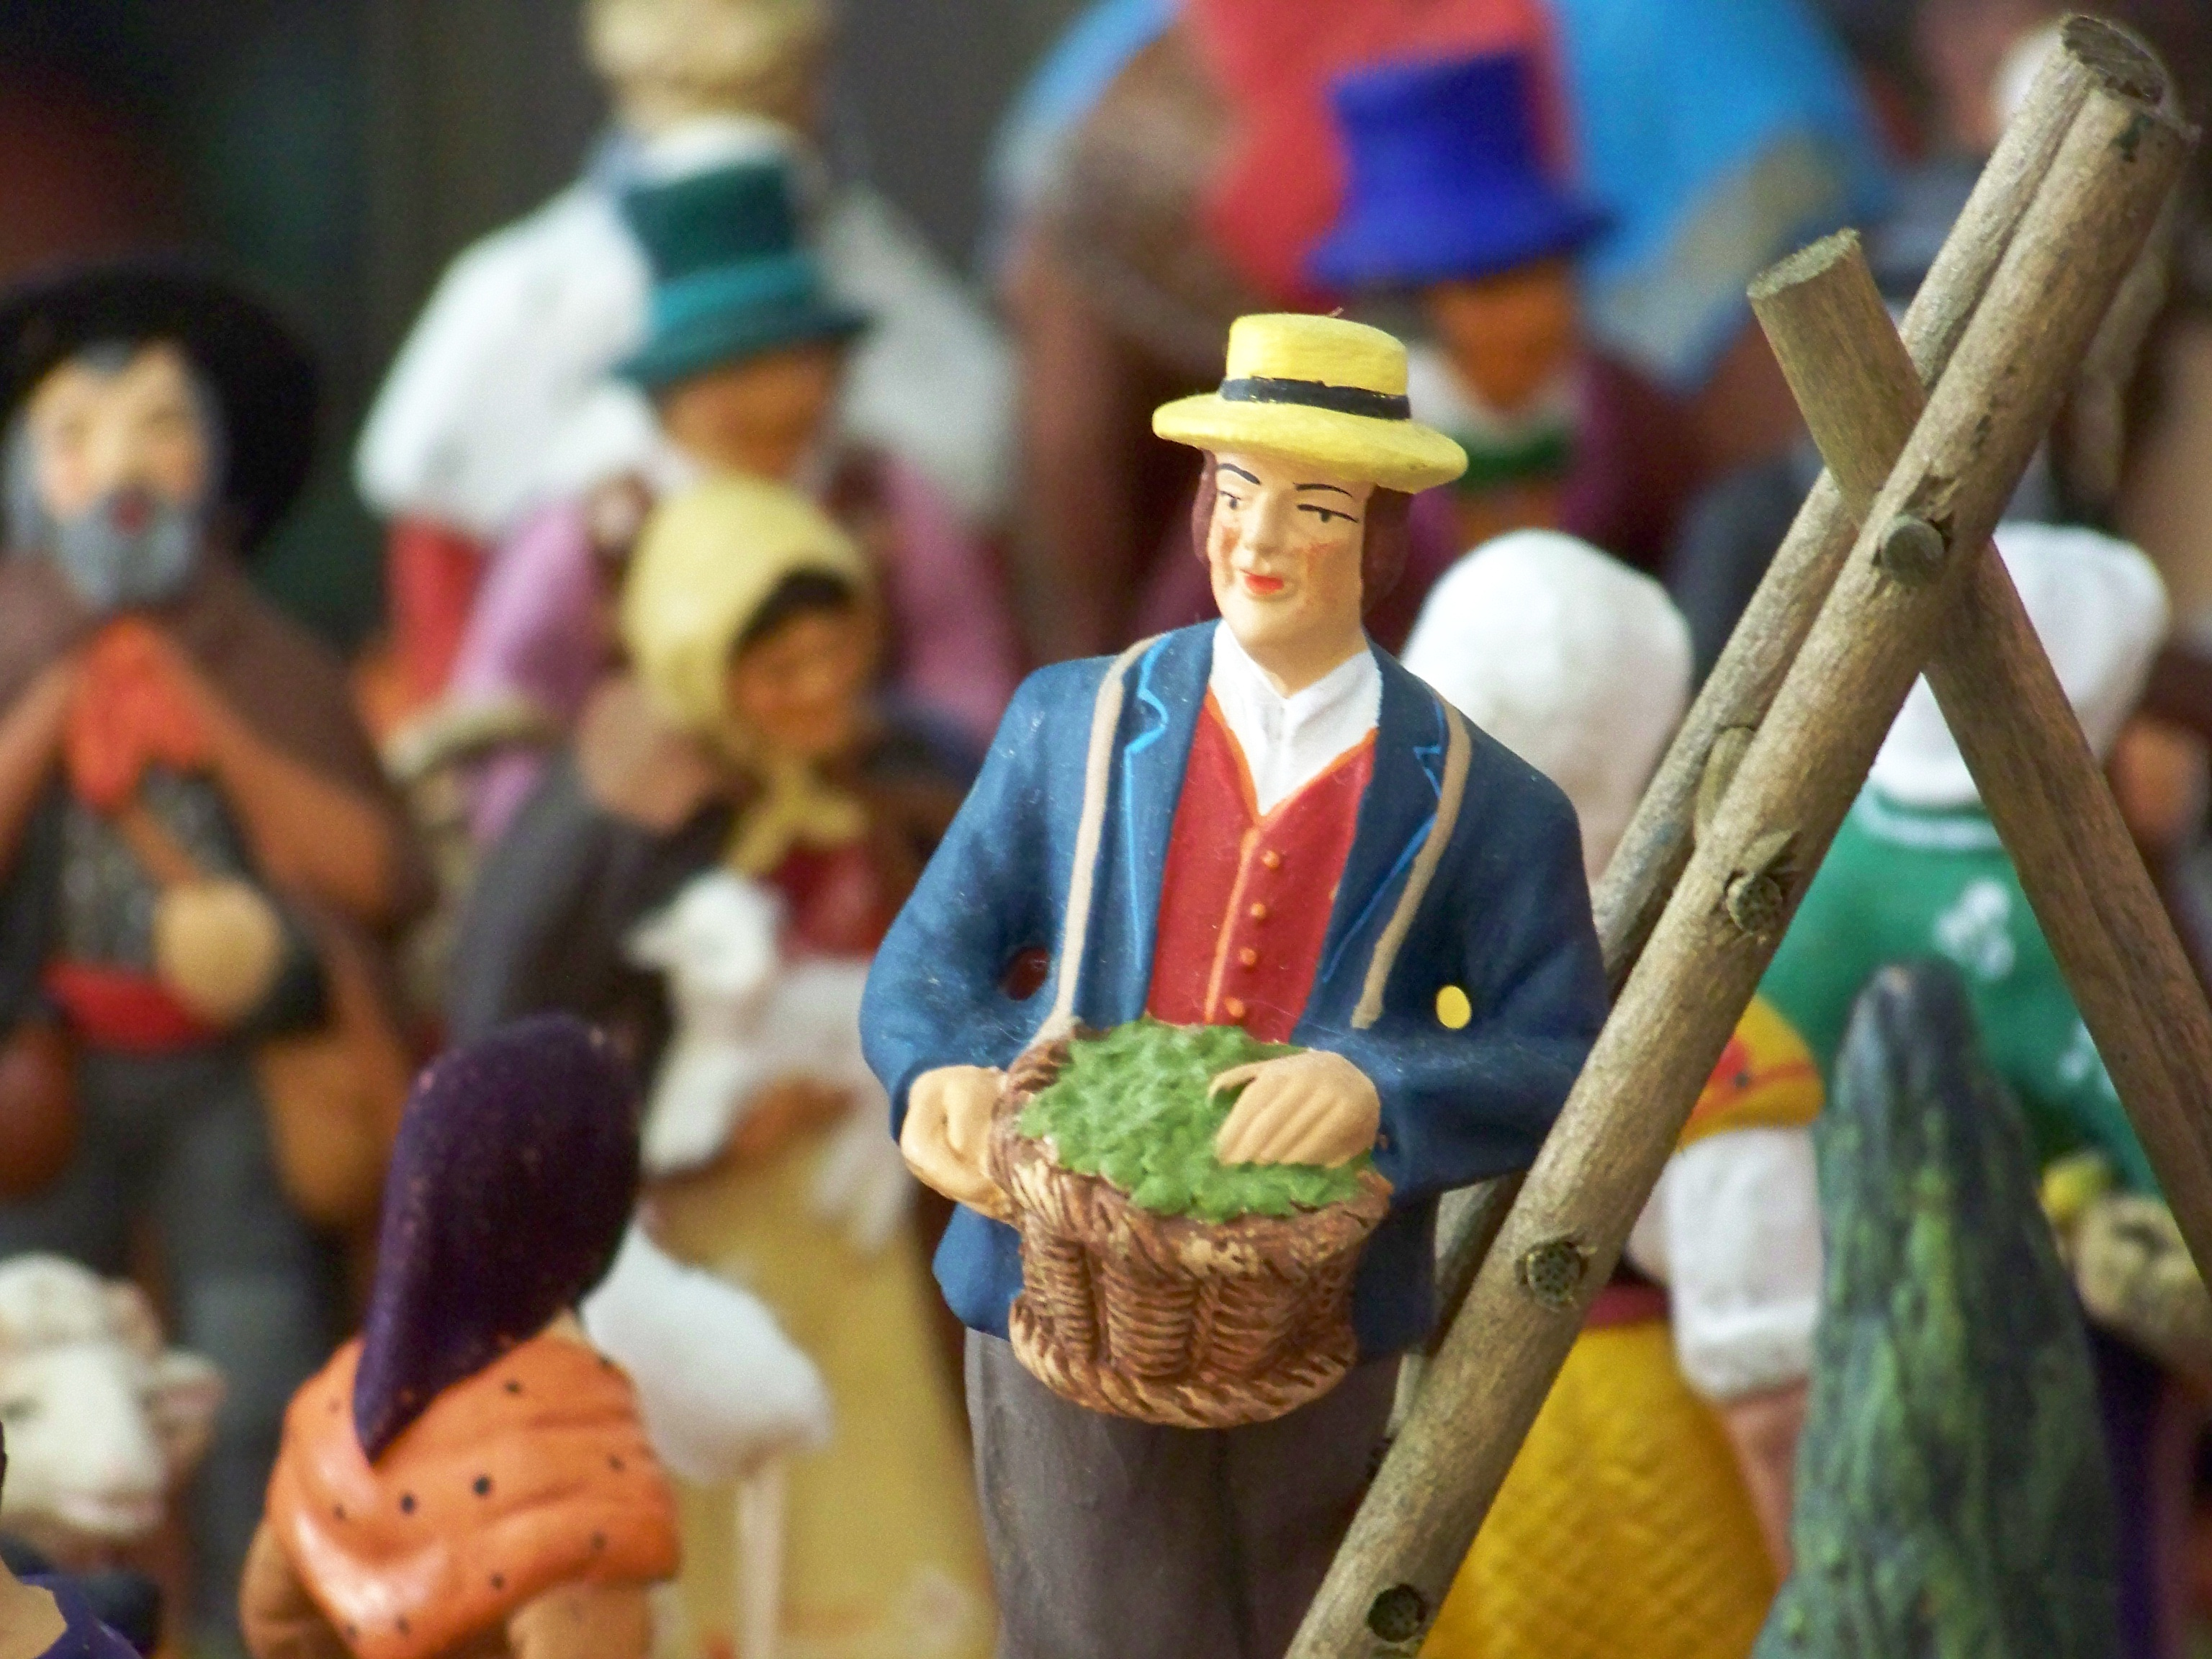
Figurine
Loule – But, you see, when he's had enough of playing the fool, when he's fed up of making people laugh, he doesn’t know what to do with himself. So he falls silent, feels strange, out of place.
[…] he’s slowly snuffed out! He turns into a figurine, trapped in the past.
Loule argues that Provençal culture and people are now out of place in their own land, and have become like the traditional local figurines that represent traditional Provençal villages, as in the previous slide and in this image:
Do you think Loule is justified in worrying about local culture?
Can you think of elements of Scottish culture that symbolise
Scotland but have little relevance to how we live today?

Slide 17
REading guide
Update your reading guide on the play.
Discuss what you can include with a partner or a group then share your ideas.

Slide 18
Character profiles
Update your character profiles based on what you have studied so far.
Discuss and share your ideas with others.

