Slide 1
Remembering Empire THe land beneath my feet
Session 6

Slide 2
THE LAND BENEATH MY FEET
This session:
Introduction to the play and context
What is pétanque?
Close analyses of sections from pages 5-9 from the printable version/ sections 0 and 1 from the online version of the play
Discussion of key scenes and groupwork
What are the Reading guide and Character profiles?

Slide 3
Introducing THE LAND BENEATH MY FEET
'In Provence, on a boules pitch, four players play petanque: Zé, the pied-noir; Yaya, the French-born son of Algerian parents; Loule, from an old Provençal family; and M. Blanc, the Parisian newly arrived in the region.'
Can you identify and explain where each character is from based on this description?
What might you expect their feelings towards the Algerian War of Independence to be?​
What is the setting of the play?

Slide 4
From the promotional materials for the play:
This play is not simply about a games of petanque between friends. We are faced with all the suffering of the Algerian War and the associated questions of identity. During the game, the past returns and we discover the secret wounds of each character and their link with this war, on the petanque pitch that brings them together and unites them...
In this dramatic comedy, memories collide.
What themes do you expect in this play? Use the words in bold to help you.

Slide 5
Trailer
Watch the trailer for the original French version of the play, Les Pieds tanqués :
https://youtu.be/5Mo5JClm1yA
You will notice that the entire play centres around a game of pétanque.

Slide 6
pétanque
What is pétanque?
A traditional game, related to lawn bowls, in which players aim to throw, toss, or roll their metal balls as close to a small ball, or jack, as possible. Any balls that finish closer to the jack than the other players’ balls gain points. It is usually played on hard ground in public spaces or on dedicated boulodromes.
What is its cultural significance?
Pétanque has long been a leisure activity in France and is widely played across France’s former colonies and territories. As a game requiring only inexpensive equipment and using public space, it is popular and accessible to all. The sport is typically played by men but is open to anyone from any background, including those who will have experienced the game outside of Provence where it remains a culturally important meeting point.

Slide 7
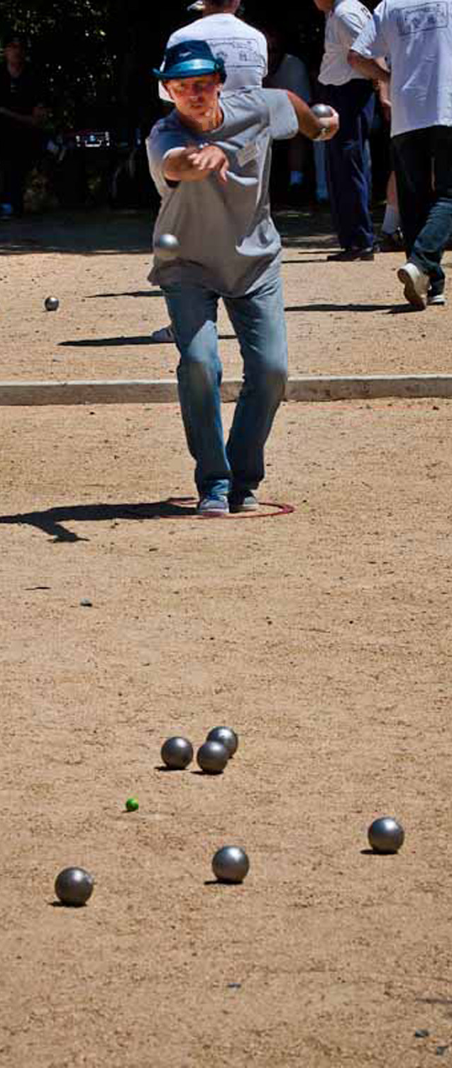
La pétanque
The name pétanque
The game’s name comes from petanca in the Provençal dialect, from the expression pè tancat [ˈpɛ taŋˈkat], meaning 'foot fixed' or 'foot planted' (on the ground), and could be translated into French as pieds tanqués (feet fixed on the ground), which is the original French title of the play.
Now, think about the significance of the English title, The Land Beneath My Feet.
As you read the play, consider the similarities with the French title and think about what the reference to 'land' adds to the meaning.
How do you play? Watch this video for Pétanque Rules
For further information, see the Introduction to The Land Beneath My Feet.

Slide 8
Excerpt Focus: Opening radio scene
Focus: page 5/ section 0
Read: the paragraph that begins 'Loule enters the playing area '. ​
Loule, the Provençal arrives to play pétanque and turns on the radio:​
As he turns the dial through various stations, a newsreader announces that a bomb has just exploded at the Saint-Michel metro station in Paris. It is 25 July 1995 and President Chirac is expected imminently at the site of the tragedy. He listens to the news for a moment then switches to another station playing music.'

Slide 9
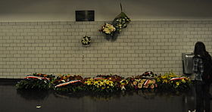
Opening radio scene
What is the context of the event on the radio?​
A bomb exploded in Saint-Michel station on the Line B of the RER train in Paris. ​
The Algerian Armed Islamic Group (Groupe islamique armé, or GIA) claimed responsibility.​
There were 8 deaths and 117 injured.​
This was part of a wave of attacks in France in 1995 that were linked to Islamic extremism and France’s approach to Algeria.​
The attack reflected tensions from France’s secularist and assimilationist policies against Algeria’s Islamic status and their memories of colonial oppression.​
Discuss: Why do you think Loule turns off the radio and its coverage of this event?

Slide 10
Opening radio scene
Why would Loule turn off the radio?​
There is a sense of the past returning as the memories of the Algerian War of Independence and related tensions between France and Algeria seep back into the present. ​
We witness Loule’s desire to ignore this event and the memories that it triggers.​
Marseille, and Provence more generally, was the destination of many pieds-noirs returning from Algeria after the Algerian War of Independence. Later, it was the destination for Algerian immigrants seeking work and a new life for their family.​
As a local Provencal Frenchman, Loule has had enough of French-Algerian conflict and resents the resultant waves of immigration into Provence. ​

Slide 11
Excerpt focus: a short memory
Read: pp. 5-7/ section 0 until 'the glory days!'​
On these pages, we hear some petanque terminology and game talk as we meet several of the characters.
Zé (pied-noir) and Yaya (Algerian heritage) arrive – why is this group interesting?
Zé insists that he can beat Loule and Yaya alone – how do the characters speak to each other at this point in the play? How would you describe their relationships?

Slide 12
Excerpt focus: a short memory
Focus: excerpt from page 6 / section 0
Loule (to Zé) – He’s right, you’ve got a short memory.
A pause.
Zé – A short memory? No, no, not me. […]
Yaya (practising his throw) – It’s that drubbing we gave him! It makes him forget things. He’s got a selective memory.
Think about which character is being accused here. How does this conversation and idea of ‘short memory’ link into the greater historical context that the play refers to?​

Slide 13
a short memory
Zé – A short memory? No, no, not me. […]
Yaya (practising his throw) – It’s that drubbing we gave him! It makes him forget things. He’s got a selective memory.
The pieds-noirs are typically represented as refusing to let go of a memory of the past which defines them, one that focuses on their victimhood, which is contested by other accounts. ​
This scene plays with that reputation, as Zé highlights that he doesn’t have a short memory, and Yaya responds that he has a selective memory instead.
This line about Zé having a short memory is ironic as he is a pied-noir, part of a group known for their attachment to a certain, selective version of the past.

Slide 14
Excerpt Focus: integrated just fine
Focus: excerpt from page 7/ section 0:
Zé – I’d be quite ‘appy to unselect you, believe me. (Moving towards Loule) Go on then, throw ‘em down. Prepare to be disintegrated.
Yaya – Not me Zé. I'm integrated just fine!
*disintegrated is a play on words. Zé is referring to knocking Yaya’s boules apart [‘disintegrating’ them in literal terms] in the game, but Yaya answers by referring to how ‘integrated into society’ he is. ​
The characters shift from talking about the boules to talking about their own identities.​
Discuss: With this in mind, why is it significant that Yaya would make the statement 'I'm integrated just fine!'? Think about his background as you discuss.

Slide 15
Excerpt Focus: integrated just fine
Focus: Page 7/ section 0 excerpt: Yaya: I'm integrated just fine!
Integration refers to the process expected of immigrants who arrive in a new country. They are expected to learn and adapt to the culture of their new country. As an idea it does not make much sense to expect people born and brought up in France to 'integrate' into it, because they have never lived anywhere else.
Yaya was born in France and has French citizenship, but he has Algerian heritage because his parents were Algerian.
Because of France's colonial past and the experience of the Algerian War, some white French people do not accept that people of Algerian origin are 'properly French', even if they have been born in France.
This raises questions of integration of immigrants into secular and assimilationist France.

Slide 16
The arrival of Monsieur blanc
Read: p. 8/ section 1 - the arrival of Monsieur Blanc
A smart gentleman, wearing a hat and dressed all in white, approaches from the other side of the playing area. The others have noticed him and watch him with slight derision. He watches them play for a moment.
If you would like to watch the scene, you'll find it on the recording [06:45-08:45]
Read pages 9-10/ sections 0-1
How is Monsieur Blanc treated by each of the others on these pages? Why do you think this is?

Slide 17
The arrival of Monsieur blanc
Read: page 8/ section 1: M. Blanc is well-dressed and is clearly new to the area. He observes before approaching.
The characters mock M. Blanc to each other: Yaya (aside to Loule) – There you go Loule, there’s your off-chance.
Loule offers M. Blanc some boules to play with them, but M Blanc has a brand-new unused set, which makes him a further target for ridicule.
He provides his full title, M. Blanc de la Martinière. This is an indicator of his upper-class background, and offers another reason for the characters to mock him. He mentions that he is building a new house for himself.
Read: page 10/ section 1: They begin to play and continue to mock M. Blanc for using the incorrect words for the game in this region. He plays poorly.

Slide 18
Excerpt focus: someone force you?
Loule – So, you’re new to the area?
Monsieur Blanc – As you can see…
Loule – Not bad round here, hey?
Monsieur Blanc – Indeed… but it's not cheap.
Zé (irritated) – Why d’you say that? Someone force you?
Monsieur Blanc – Force me?
Zé – To come ‘ere?
Monsieur Blanc – No, why?
Yaya – Someone came to his house one day and told him to beat it. He ain't got over it since.
Monsieur Blanc smiles slightly, a little embarrassed.
Focus: excerpt from page 10/ section 1
What are Zé and Yaya referring to here? Why is Zé 'irritated'?
Why would M Blanc feel 'embarrassed'?

Slide 19
Excerpt focus: someone force you?
Focus: excerpt from page 10 / section 1
What are Zé and Yaya referring to here? Why is Zé irritated?
They are referring to the fact that at the end of the Algerian War of Independence, the pieds-noirs, including Zé, had to flee from Algeria to France for refuge.
Why would M Blanc feel embarrassed?
M Blanc is often quite naïve. He doesn’t understand what is being referred to at first here. He has come to Provence to buy land and build a new home, and has implied that this has been challenging. However, in comparison with Zé’s forced move to Provence, he is in a very privileged position, which they are trying to make him aware of.

Slide 20
Excerpt Focus: I am from round here!
Yaya – You're lucky, you are, Monsieur Blanc. You know, no- one ever asks me (fawning): “So, you're new to the area?”
Monsieur Blanc (awkward and still yet to throw) – I entirely understand how you feel... When you're not from around here, they tend to let you know about it...
Yaya (annoyed) – Hang on now, Monsieur Blanc, I am from round here! Can you believe this guy? (Accentuating his accent) Ain't it obvious from how I speak?
Zé – From ‘ow you speak, yes. From ‘ow you look, no.
Focus: excerpt from page 11 / section 1
Why is Yaya annoyed at M Blanc?

Slide 21
Excerpt Focus: I am from round here!
Yaya – You're lucky, you are, Monsieur Blanc. You know, no- one ever asks me (fawning): “So, you're new to the area?”
Monsieur Blanc (awkward and still yet to throw) – I entirely understand how you feel... When you're not from around here, they tend to let you know about it...
Yaya (annoyed) – Hang on now, Monsieur Blanc, I am from round here! Can you believe this guy? (Accentuating his accent) Ain't it obvious from how I speak?
Zé – From ‘ow you speak, yes. From ‘ow you look, no.
Focus: excerpt from page 11 / section 1
Why is Yaya annoyed at M Blanc?
M Blanc has implied that Yaya is not 'from here'. However, Yaya has lived his entire life in France. Yaya’s appearance suggests his Algerian heritage and M Blanc’s question implies that he sees him as a foreigner.

Slide 22
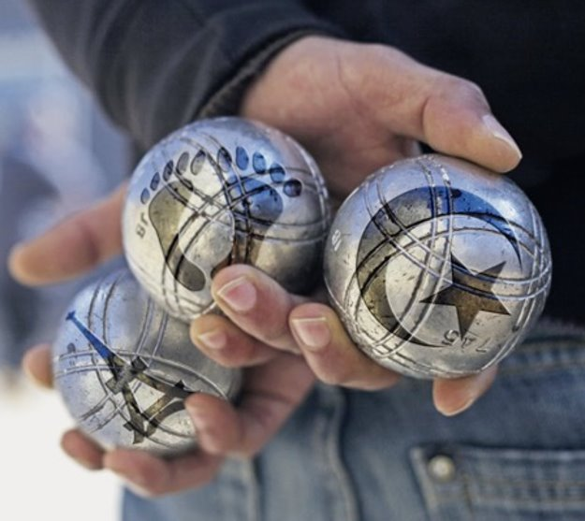
Reading guide
Each week, we will update two documents
a reading guide on the play
character profiles
Discuss what you can include in these documents with a partner or a group.
If you have time, share your ideas with other groups.
Add your notes from this week.

