Slide 1
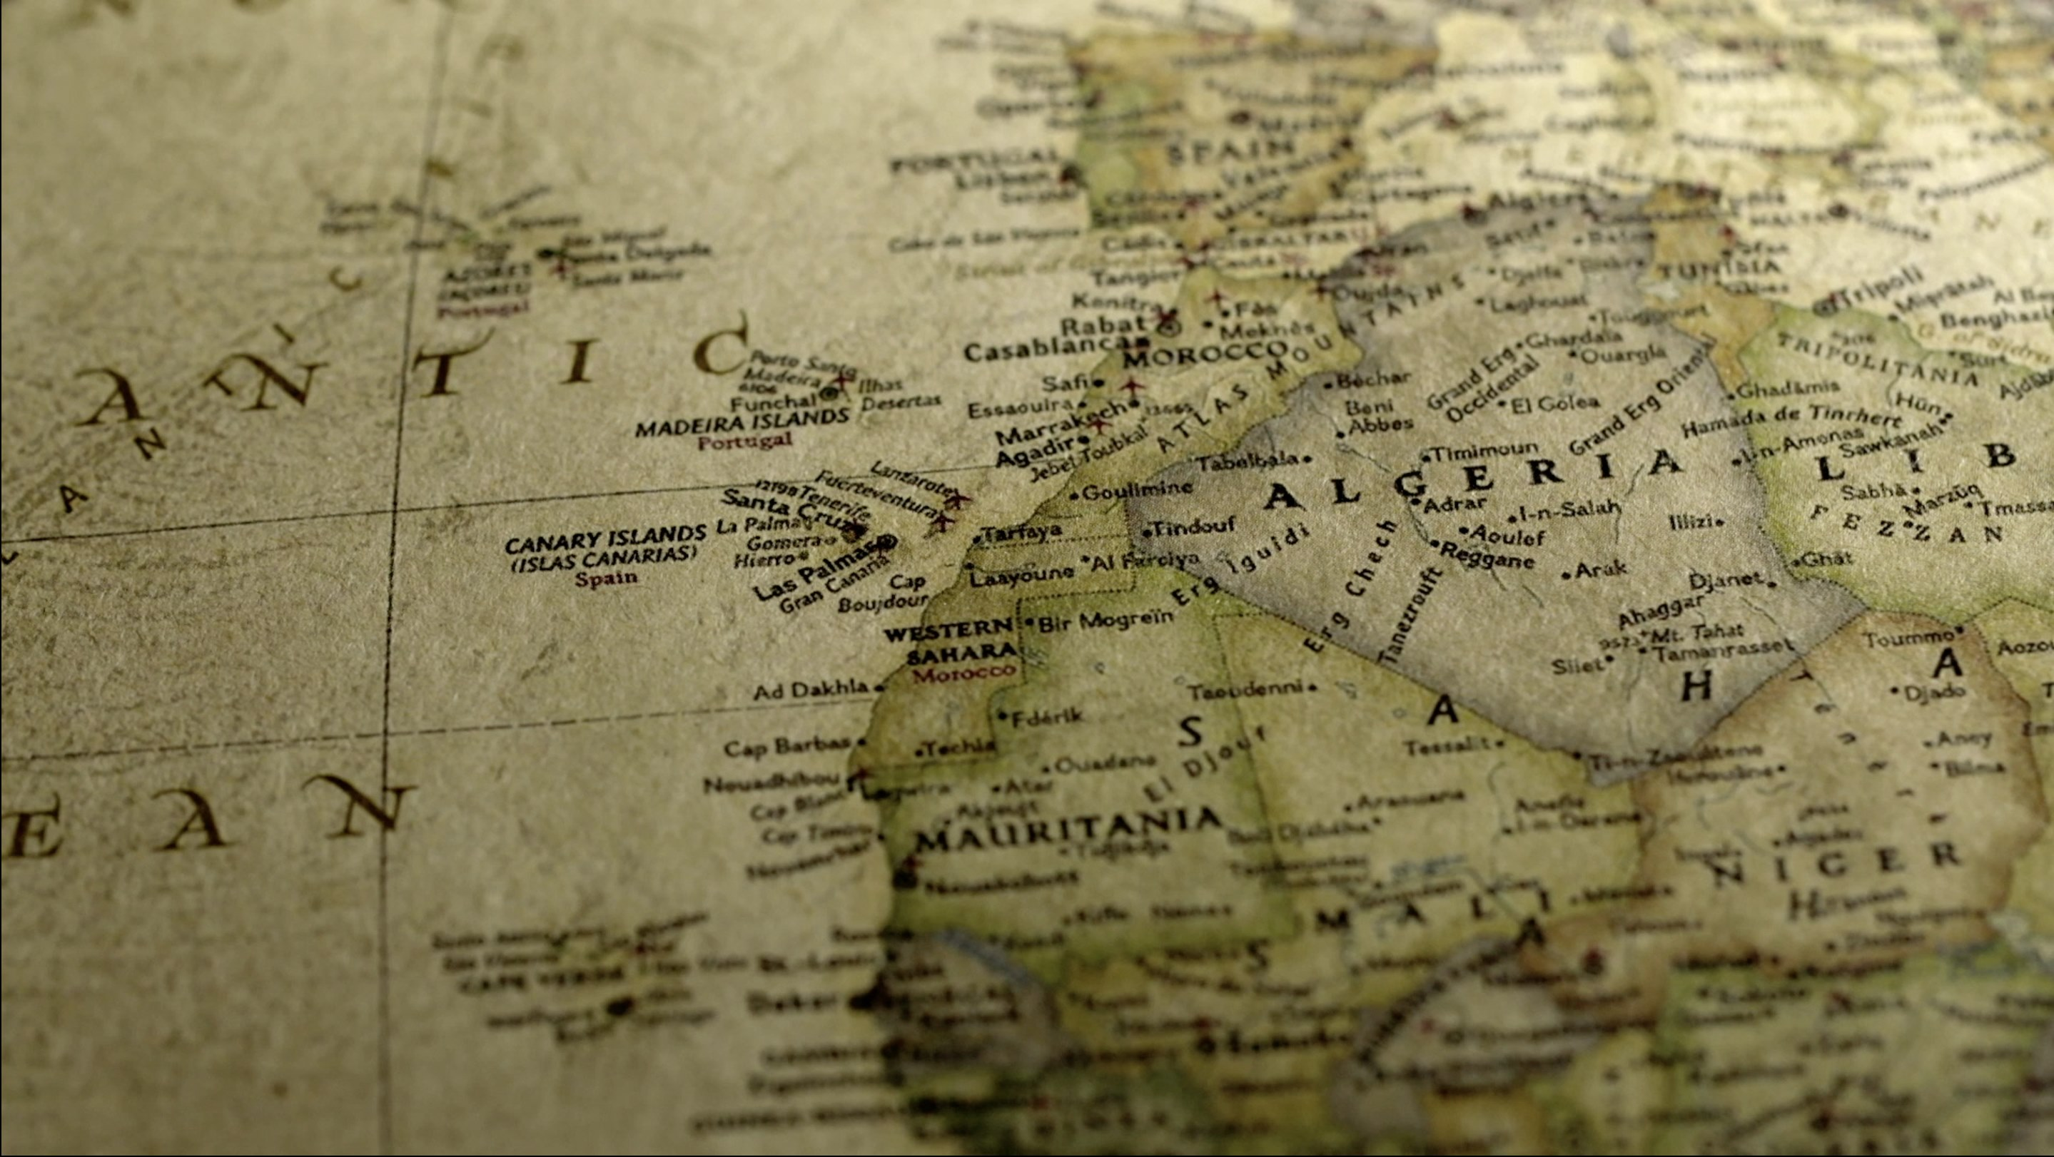
Remembering Empire
Session 2: Settling Algeria from 1830

Slide 2
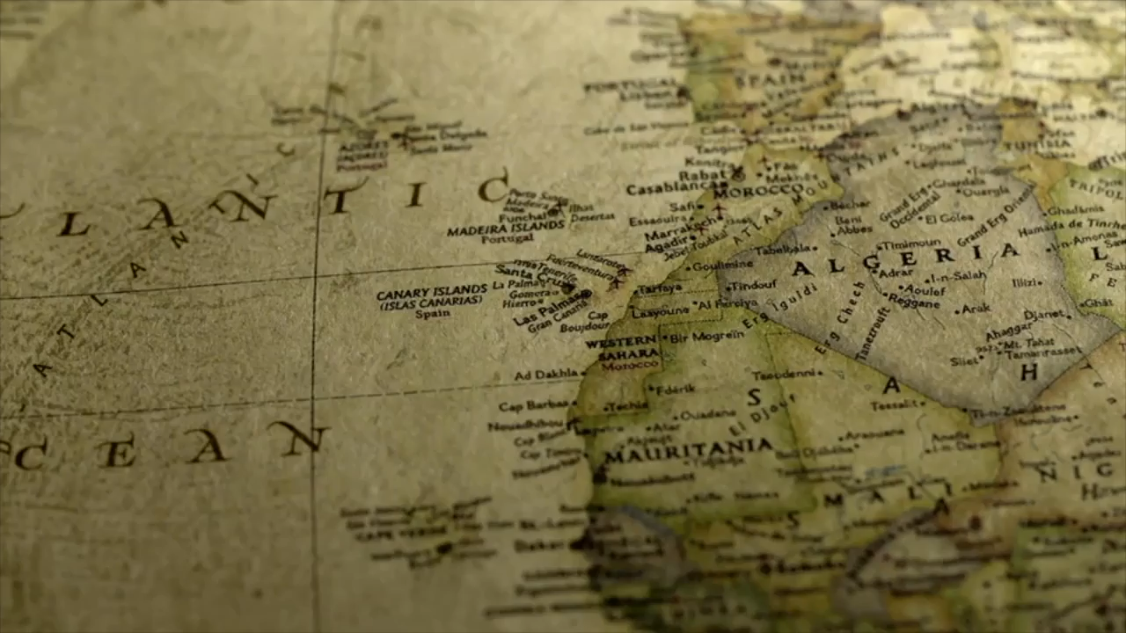
Invasion: The Sword
According to Jennifer Sessions, colonisation is achieved through the sword (the violence of invasion) and the plough (the settlement of the land). Watch this 5-minute video about the conquest and settlement of Algeria. Take notes on what you notice about it.

Slide 3
This session
In the last session we saw how groups highlight their suffering in order to make a case for why people should listen to their version of the past. We called this 'competitive memory', and we said that it occurs in relation to many periods of history. One of these is the colonisation of Algeria.
In this session we will look at the groups who were the genuine victims of the French colonisation of Algeria.

Slide 4
Writings by early European settlers in Algeria is largely silent on the presence of the indigenous Arab and Berber peoples, who often are present only in the margins.
This is partly because a lack of formal education meant that the Arabs and Berbers were illiterate and did not keep written records but it also reflects a more sinister reality: the victims of French violence often did not survive to tell their stories.
Literature therefore ignores the terrible consequences of France’s colonial policies for the indigenous populations.
While they were less vulnerable to the diseases brought by the settlers than the natives of America or Australia, it is estimated that 20-25% of the 4.2 million Muslim Algerians died in the mid-1860s as a direct result of the French seizing their lands in the previous decades.

Slide 5
The first injustice of empire was the direct violence of invasion. The French army led a brutal campaign of oppression which targeted both civilians and armed resistance. One notorious technique used in the early years of colonial conquest was the enfumade [the practice of suffocating with smoke], used notably in 1844 and 1845.
In one infamous incident in 1845, Algerian resistance fighters took refuge in a cave near Dahra, in northern Algeria, along with 600 members of the Ouled Riah tribe who were fleeing the oncoming army. On 18 June 1845, French Lieutenant-Colonel Pélissier ordered fires to be set outside the mouth of the cave, suffocating all of those sheltering within.

Slide 6
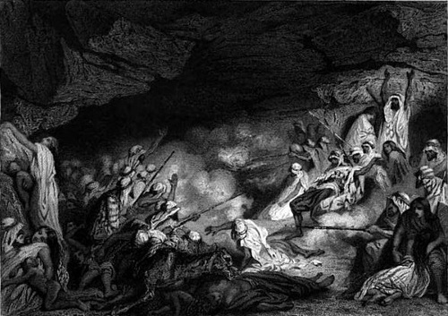
Les Grottes du Dahra
(The Caves of Dahra)
Tony Johannot
1845

Slide 7
Witness accounts
The enfumades became a symbol of the brutality of the French invasion and a strong rallying point for Algerian resistance in the following century of colonial rule. However, the few contemporary records of the practice were written from the perspectives of the French bystanders who wrote witness accounts of the atrocities.
Why might that be?

Slide 8
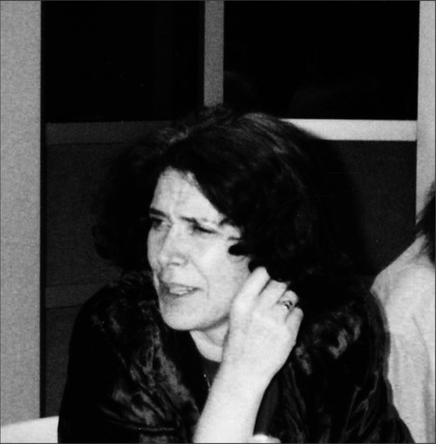

Fantasia, An Algerian Cavalcade
(in French, L'amour, la fantasia)
Assia Djebar 1985
Why would there be few records left by the Arabs involved in the enfumade?
Remember that most Arabs and Berbers were illiterate, and that most of those trapped in the caves did not survive.

Slide 9
Assia Djebar
In her novel, Fantasia, an Algerian Cavalcade (1985) the Algerian writer and filmmaker, Assia Djebar, grapples with the limitations of a historical narrative dominated by the accounts of the conquerors. This is because only French sources are available to tell the history of the invasion of Algeria. To counter this, in the novel she recounts the Dahra enfumade from a range of different perspectives.
Djebar describes how Pélissier's soldiers were guided by a rival Arab tribe to follow the inhabitants of the Ouled Riah tribe as they took refuge in the Dahra caves, and how they surrounded them and built large fires. Then she changes approach and focuses on two eye-witness accounts, one of a Spanish officer serving in the army, and the other an anonymous soldier who wrote of the enfumade in letters home.

Slide 10
Pélissier
Finally, in the following extract Djebar writes as a novelist trying to reimagine the response and motivations of Pélissier himself.
Would he have gone into the caves himself? If so, how would he have reacted?
All we have to go on are the words that he wrote in his military report. So Djebar wonders: did he gaze on the consequences of his actions? And if he did, what did he do, and what should we do, with the memory of the event?
All that is left are words: the bodies become words that travel in his report and reach Paris, causing outrage:

Slide 11
Did Pélissier himself enter the caves personally? Some ask. The third day of the tragedy is 22 June, the day when the colonel makes his report. He is supposed to have said, as he emerged, ‘It’s horrible!’
Others report that he sighed, ‘It’s terrible!’
Be that as it may, he states, in the prescribed report:
‘These operations, Field-Marshal, are such as one undertakes when obliged to do so, but one prays to God that one will never again have to carry them out!’ […]
It is time to depart, the stench is too great. How can one get rid of the memory? The corpses exposed in the hot sun have been transmuted into word. Words can travel. The words, for example, of Pélissier’s verbose report, which arrive in Paris, are read at a parliamentary session, unleash a uproar of controversy: insults from the opposition, embarrassment on the part of the government, fury of the warmongers, shame throughout Paris, in which the seeds of the 1848 Revolution are germinating …
The closing lines refer to the impact of the enfumade on the 1848 Revolutionary atmosphere in Paris, and so they remind us of the effect that events in Algeria had on the history of France. They are entwined.

Slide 12
Discuss
We often say that 'history is written by the victors'. Thinking about the Dahra massacre, what are the difficulties in trying to produce an accurate history of colonisation?
We have mentioned illiteracy, and the fact that colonised peoples often did not survive the colonial encounter. Are there any other difficulties for the historian to overcome?

Slide 13
Competitive victimhood
Since World War Two, there has been a move to focus more on the victims of history (most notably the victims of the Holocaust) and their suffering. This has led to the development of international law, and a focus on universal human rights. The aim has been to ensure that the history of World War Two should never be repeated.
However, the researcher Michael Rothberg has argued that in focusing on commemorating suffering there is a danger of creating competitive victimhood, where groups shout louder and louder about how much they have suffered. They hope that by arguing that their human rights have been violated, their claims may be acknowledged.

Slide 14
Discuss
Last week we said that memory often operates in a competitive way: the groups that shout loudest succeed in shaping the 'official' version of history.
But the ultimate victims (of war, violence or colonisation) often are no longer with us to make their voices heard.
So whose version of history will we hear?
Is that problematic?
What should we do about it?

Slide 15
Invasion: The Plough
The other side of the story
The early settlers did not think of themselves as invaders. Like the emigrants who left Britain to settle in Canada, America and Australia, they saw themselves as brave pioneers blazing a trail through an empty and inhospitable wilderness. They told stories that emphasised their courage in building a new country in the face of difficult challenges. These challenges also led to suffering and death for many of the new arrivals.

Slide 16
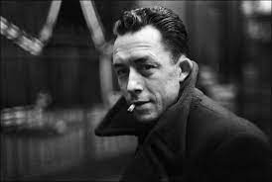
Albert Camus
Albert Camus was a journalist, writer and intellectual.
He was born in colonial Algeria and is
perhaps the best known of the French settlers of Algeria.
In 1957 he won the Nobel prize for
Literature.
He was killed in a car crash in 1960
at the age of 46.

Slide 17
When Camus was writing in the 1950s in the midst of the Algerian War of Independence, there was a widespread belief in mainland France that the majority of the settlers were rich, and that they had become rich because they oppressed and exploited the native Arab Muslim population.
Camus aimed to correct this in his novel, The First Man, which emphasises the factors – unemployment, poverty and hopes of a better life – which drove many to emigrate. It reminds the reader that the French state encouraged colonisation and presents the settlers as suffering in their new lives.

Slide 18
In this extract from Camus' novel, The First Man, the narrator re-imagines the invasion from the perspective of French settlers as early pioneers:
Details from their conversation at the doctor’s came back to him on the same wave as those barges that, according to the doctor, had brought the Parisian settlers to Solférino. […] Then, six barges hauled by draft horses, with the ‘Marseillaise’ and the ‘Chant du Départ’, of course, played by the city’s brass band, and the benediction by the clergy on the banks of the Seine with the flag on which was embroidered the name of the village that did not yet exist but the passengers would create by magic. The barge was already underway, Paris was slipping away, becoming fluid, was going to disappear – may God bless your undertaking – and even the strongest of spirits, the tough ones from the barricades, they fell silent, sick at heart, their frightened wives clinging to their strength, and in the hold they had to sleep on rustling straw with the dirty water at eye level, but first the women undressed behind bedsheets that they held up in turn.

Slide 19
[...] Later on, they built the village with earthen walls. But two-thirds of the emigrants were dead, there as everywhere in Algeria, without having laid hands on a spade or a plough. The others remained Parisian in the fields, ploughing in top hats, gun on their shoulders, a pipe between their teeth – and only pipes were allowed, never cigarettes, because of fires – and quinine in their pockets, quinine sold in the cafés in Bône and in the canteen in Mondovi as an ordinary drink, to your health, accompanied by the wives in silk dresses, But always the gun and the soldiers around, and even to do the laundry in the Seybouse [river] an escort was needed for those who in the old days would hold a peaceful salon while working at the washhouse in the rue des Archives; and the village itself was often attacked at night.

Slide 20
Here we see the settlers receiving an official send-off from Paris, with the national anthem played by the city band and the barges blessed by the priest. Camus wants to emphasise that in sailing to new lives in Algeria the settlers were carrying out French government policy.
They are not described as fierce invaders, but as poor and frightened families badly prepared for the challenges ahead. Camus says that two-thirds of them died quickly from malaria, for which the only treatment was quinine, before they were able to build their new villages.

Slide 21
Discuss
The first settlers are often described as pioneers, building a new country from nothing. What words do you associate with 'pioneers'? What countries do you associate pioneers with?
How would you describe the settlers in Camus' text? How do you feel towards the people mentioned in it? Can they be seen as victims?
These pioneers had to defend themselves at all times against attacks by the violent natives. As a version of colonisation, it is very different from Djebar's account. Compare the two texts: both refer to suffering and death. Who is held responsible in each?

Slide 22
Discuss your answers
‘Pioneer’ is a very positive word, used to describe achieving something for the first time, and ‘breaking new ground’. It is associated with bravery, ingenuity, masculinity and self-reliance. We often think of pioneers in connection with America or Canada, and the idea of men pushing forward into undiscovered lands. Of course, those lands were not undiscovered to the peoples living there, who experienced the arrival of the ‘pioneers’ as an invasion.
The settlers in Camus’ text are described as being afraid despite their toughness. The women are frightened. All are unprepared for what awaits them and many will quickly die. In this sense they may be seen as victims.
Djebar concludes her section by mentioning the responses of the authorities in Paris, and Camus is careful to emphasise the role of the French state in sending the settlers to Algeria. Both highlight the role of the state in contributing to suffering and death.
Thinking back to the analogy of competitive memory being like children arguing and blaming each other, we can see that the French state is much more involved in colonization than the benevolent carer in the analogy.

Slide 23
Settler life in Algeria
Finally, we turn to the official government depiction of life in Algeria. It shows a very different way of presenting and understanding the process of colonisation.
The following extract is from a 1948 propaganda documentary commissioned by the General Government of Algeria (Gouvernement Général de l'Algérie). It shows a romantic vision of the conquest and settlement of Algeria through the idealised story of the settlers who founded an imaginary Algerian village:

Slide 24

Settler life in Algeria
Watch this 2-minute video and answer the questions on the next slide.

Slide 25
Discuss
What words would you use to describe the settlers in this extract? How is the land presented - does it belong to anyone? Is it empty? What do the settlers do with the land?
From what you have read, do you think that this is realistic? If not, why has the French government made the film?

Slide 26
Discuss your answers
1. The location in the film and the settlers who feature are idealized. The film is like a fairy-tale or fable: it takes place in no particular time or place. The settler is creating something new out of empty space; there are no traces of other people. The house rises up as if by magic through the productiveness of the settler, who makes something from nothing.
2. The scenario is unreal because it contains no details that mark it as a historical event. There is no mention of conquest, of administration, of challenge and contest over the legal title to the land, or of the stages in a building project. The French government emphasizes the ease with which settlement takes place to encourage viewers to see French occupation as natural, and to attract new settlers to Algeria.
In 1962 Algeria became independent. As it became clear that the settlers were going to have to leave, the stories of how the pioneers made French Algeria became especially important to them, as a way of justifying their presence there. If they had built French Algeria out of nothing and on empty land, then they had a moral right to stay.

Slide 27
Test your knowledge!
1. Who was Assia Djebar?
A historian from the 19th century
A 20th century historian, writer and filmmaker
A witness of the Dahra 'enfumade’
2. The initial invasion of Algeria was partially motivated by which political crisis in France?
The French revolution of 1789
The 1848 revolution
The dying Bourbon monarchy
3. Why was the figure of Saint Augustine so important to the European settlers of Algeria?
He was originally from the region that would become France
He was the Christian bishop of Hippo in Algeria
He founded the city of Annaba

Slide 28
Test your knowledge!
1. Who was Assia Djebar?
A historian from the 19th century
A 20th century historian, writer and filmmaker
A witness of the Dahra 'enfumade’
2. The initial invasion of Algeria was partially motivated by which political crisis in France?
The French revolution of 1789
The 1848 revolution
The dying Bourbon monarchy of 1830
3. Why was the figure of Saint Augustine so important to the European settlers of Algeria?
He was originally from the region that would become France
He was the Christian bishop of Hippo in Algeria
He founded the city of Annaba

Slide 29
Test your knowledge!
4. According to Albert Camus, how were the early settlers represented?
As skilled farmers transforming barren earth into rich farmland
As akin to the fearless cowboys of the Wild West
As 'persecuted-persecuters' who left France poor but were richer than the oppressed Algerian population
5. Why did the romantic vision of the early settlers become important around 1949?
It was the centenary anniversary of the French invasion of Algeria
The Algerian War of Independence had begun
Support for Algerian nationalism had risen following the Second World War and the Sétif massacre on 8 May 1945

Slide 30
Test your knowledge!
4. According to Albert Camus, how were the early settlers represented?
As skilled farmers transforming barren earth into rich farmland
As akin to the fearless cowboys of the Wild West
As 'persecuted-persecuters' who left France poor but were richer than the oppressed Algerian population
5. Why did the romantic vision of the early settlers become important around 1949?
It was the centenary anniversary of the French invasion of Algeria (no, that was 1930)
The Algerian War of Independence had begun (no, it began in 1954)
Support for Algerian nationalism had risen following the Second World War and the Sétif massacre on 8 May 1945

Slide 31
Scottish settlers
The people who emigrated to Algeria from 1830 did so to seek a better life. Many others also left European countries to settle other countries as part of colonial invasions. In doing so, European settlers contributed to indigenous peoples losing their land and rights.
For example, recent research in Scottish literature and history has emphasised the important role played by Scottish settlers who emigrated to the so-called 'New World' of North America, or other territories such as Australia and New Zealand. The native Americans and Aboriginal peoples all suffered from the arrival of British settlers.

Slide 32
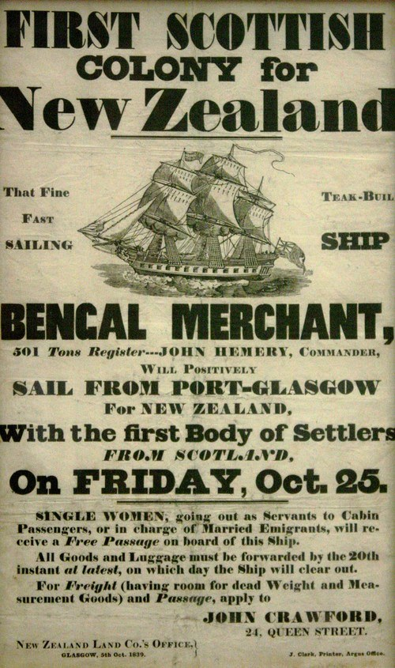
This poster from 1834 - four years after the invasion of Algeria by the French - encourages Scottish people to emigrate to New Zealand.
How do we remember Scottish emigrants? Why do you think they left Scotland? You can use the internet to find out about events such as the Highland Clearances, and transportation to Australia. Many people were forced to leave Scotland by poverty or dispossession.
Do you think their experiences were similar or different to the settler experience as told by Camus?
Does the French settler memory of the early years of French Algeria remind you of any other historical contexts?
Poster advertising emigration to New Zealand from Glasgow in 1839

Slide 33
Discuss
In what ways are the memories of the early years of French Algeria 'competitive'?
Are you surprised that the 'pioneer' myth of the brave frontiersman exists in different European cultures?
How do you think the indigenous peoples of America, Canada, Australia and New Zealand felt about Scottish settlers emigrating to their land?
Take your time to think about these questions and discuss them with others in the class.

Slide 34
Key points from this session
Colonial violence meant that its victims often did not survive to tell their stories. Most historical records were written by the invaders. So, to recover the stories of the indigenous peoples, a writer must look for the gaps and reconstruct their experiences.
The first settlers did not see themselves as invaders or oppressors, but as poor pioneers seeking a new life in an empty wilderness. They left Europe for an unknown future where many suffered and died in the process of building their new country.

