Slide 1
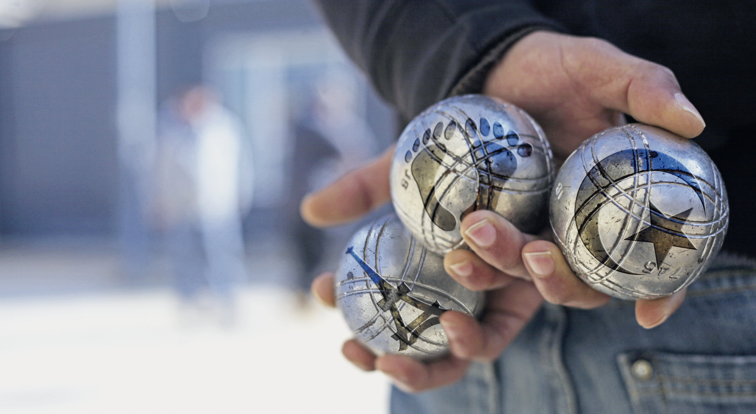
Remembering Empire
THE LAND
BENEATH MY FEET
Session 10

Slide 2
The land beneath my feet
This session:
The play’s ending – pages 41-45 in the printable version of the play
Online sections 9-10.
Completing the Reading guide and character profiles
Brainstorming possible ideas for an essay.

Slide 3

Questions for discussion
From what you know so far:
Why do you think this is the marketing image for the original French play? What do the symbols on the boules stand for? Can you explain the meaning behind the image?

Slide 4
Why do you think this is the marketing image for the original French play? Can you explain the meaning behind the image?
The boules are gathered together to be played against each other. Each one has a symbol of a particular group: the pieds-noirs (literally means 'black feet'), the mainland French (Eiffel Tower), and the Algerian people (Algerian flag). This reflects the different cultures and memories that are present in the play. For much of the play they appear to be in conflict – but the image shows them as part of the same game.

Slide 5

Discuss:
How do personal experiences and Family memories impact the characters’ interpretations of history?

Slide 6
'No!'
Read: p. 41 from Monsieur Blanc: The empire has shrunk... until p. 42 has survived through it all!
How is Loule portrayed as isolated or in opposition to the other three characters in this scene?
What is the tone of Yaya and Zé's statements? Is it effective in persuading Loule?

Slide 7
'No!'
How is Loule portrayed as isolated or in opposition to the other three characters in this scene?
While the others use longer sentences, Loule is only responding by shouting ‘no!’.
2. What is the tone of Yaya and Zé's statements? Is it effective in persuading Loule?
Yaya and Zé are speaking sarcastically to Loule. They imitate and mock his views and ways of expressing them. This further disengages and angers Loule.

Slide 8
Provence
Read to the end of p. 42:
Yaya looks at Loule, who hasn't moved.
(Becoming more persuasive). Survived through thick and thin! Because all these migrants and the conquerors too, whether it’s the northern barons or today’s concrete-obsessed developers from the world over...They've all become locals too, without even meaning to: inhabitants of a peaceful land, a land of brotherhood, where gentleness, elegance and love always win out over garishness, vulgarity and violence.
Everyone looks at Loule.
Do you agree with this description of Provence and its history?

Slide 9
Play ending: A lost utopia?
Read: p. 43 until ‘Wouldn’t that be nice?’
Yaya (collecting his boules) – Well maybe if you’d shown a bit more willingness for us to learn then perhaps you could have stayed over there...what d’you reckon to that? Algeria: a subtle mix of Muslims, Christians and Jews living together in peace, side by side, as equals. The most glorious and largest region of France...of the European Union! Wouldn’t that be nice?
What is Yaya suggesting?

Slide 10
Play ending: A lost utopia?
What is Yaya suggesting?
Yaya suggests that if Algeria had not chosen independence, it could have been a utopian space [an imagined perfect place] where different religions lived in peace as the most beautiful region of France or even the EU. He argues that this was possible and would have been beautiful.
It is notable that this suggestion is made by Yaya, whose Algerian father fought for independence.

Slide 11
Play ending
Read:
Monsieur Blanc – And what if this region you speak of already existed? Doesn’t that same Algerian experience, that started way back in 1830, have every chance of succeeding here, in Provence, in the 21st century? Like it's been transplanted to this side of the Mediterranean? What do you think? (They all stare at him, dumbfounded) Loule? What do you think about that?
What does M. Blanc propose in response?

Slide 12
Play ending
M. Blanc argues that this utopia is still possible, but that it could instead be in Provence.
Do you agree with M. Blanc that Provence could be a harmonious space for diverse peoples to live in unity?
Why/why not?
Is this a utopian (impossible ideal) vision? Is it intended
as a possibility, or does it simply demonstrate the new
understanding between the characters?

Slide 13
Groupwork
Read and compare: Read from the last line of p. 43 ('You've got a short memory!') through pages 44 and 45 (section 10 to the end)
Compare this with pages 6 ('He's right, you've got a short memory') to 10 (section 0):
How has the dialogue changed from before? What is similar and what is different?
What is the effect of this?

Slide 14
Groupwork
Comparing pages 43-45 with pages 6-10.
Notice the repetition of:
You've got a short memory
You're new to the area / you're new round here
Not bad round here, hey? / we’ve settled in pretty well round ‘ere now, 'aven't we?
Disintegrate
what a duff shot! / Duffer
Who says these lines in each instance? Why has Chuyen made changes and what is their effect?

Slide 15
Groupwork
Who says these lines now? Why has Chuyen done this?
The close of the play sees the characters repeat the play’s opening discussions, but subtly altered. Different people repeat each other's lines now. These changes reflect a new harmony and understanding between them. Importantly, to be able to repurpose and repeat other people's lines the characters must first have listened to and heard the speaker. This suggests that even in moments of conflict the arguments have not been a 'dialogue of the deaf' but a genuine exchange.
we’ve settled in pretty well round ‘ere
The inclusion of the word 'settled' adds a hopefulness in this ending. It plays with the idea that they could all be rooted peacefully together in Provence.

Slide 16
Reading guide
Update the reading guide.
Discuss what you can include with a partner or a group then share your ideas.

Slide 17
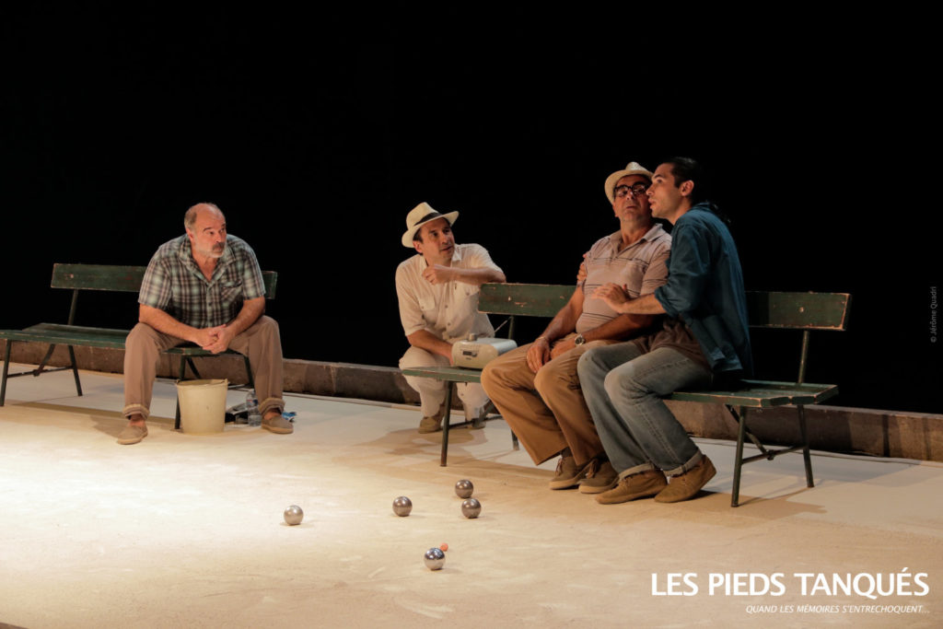
Character profiles
Update your character profiles based on what you have read this week.
Discuss what you can include with a partner or a group then share your ideas.

Slide 18
Essay-writing
Brainstorm on possible ideas for the focus of your essay using your reading guide.
In pairs, discuss ideas you have had for your focus.

Slide 19
essay
The final session will focus on approaches to writing your essay.
As preparation, you might like to consider this possible title:
'To what extent does The Land Beneath My Feet conform to the model of 'competitive memory' in its representation of the Algerian War and how is this demonstrated in the play?

