Slide 1
Remembering Empire Les Pieds tanqués
Session 9

Slide 2
Les Pieds tanqués (2012)
Today’s pages:
Pages 18-22 in the printable version of the play
Themes: Immigration, multiple histories
Online Sections:
8. Yaya’s Algerian family, including Harki uncle (until il a assez donné va.)
9. Immigration to Provence, France, and Loule’s resentment (until Ça y est, vous avez fini ?)

Slide 3
La France, il faut l’aimer
Read: page 18 from 'Ze: tu vois Yaya...' until 'un temps.'
Loule questions Yaya’s love for France.
Loule – Ça suffit pas ! La France, il faut l’aimer.
Yaya – L’aimer ? Et c’est toi qui délivres les permis ?
Monsieur Blanc (à Loule) – À trop l’aimer, vous voyez ce qu’il advient.
Loule – Tu nous dis que tu l’aimes, mais qui nous dit qu’au fond de toi, tu ne lui en veux pas à mort ?
Yaya – Pense ce que tu veux. Je n’ai jamais cessé de l’aimer.
Loule – Tu peux le prouver ?
Why does Loule ask Yaya to prove his love for France, but not the other characters? Is this fair?

Slide 4
La France, il faut l’aimer
Why does Loule ask Yaya to prove his love for France, but not the other characters? Is this fair?
Loule dislikes that Yaya is critical of France and defensive of Algeria. The fact that he is of Algerian parentage also adds to his critique of Yaya, even though he has always lived in France.
Discuss:
Do you agree with Loule that ‘La France, il faut l’aimer’? Does one have to love one’s country?
Does it change things if the person is an immigrant or, as in Yaya’s case, the son of immigrants?

Slide 5
Yaya’s family
Read: page 19 from 'elle est idiote...’ to end of page
We learn about Yaya’s family, including his uncle who was a harki.
Yaya – Un père F.L.N. arrêté par les paras et qu’on n’a jamais revu. Un oncle harki massacré sur le quai d’un embarquement qu’on lui refusait…
Zé – Harki ?
Yaya – Oui, mon oncle. Au moment de larguer les amarres, le capitaine du bateau a reçu l’ordre de débarquer les Harkis qui étaient à son bord : il s’est fait assassiner sous le regard des vrais soldats français accrochés aux rambardes !
Who were the harkis?
What does this show about the differences that were possible within even just one family?

Slide 6
Yaya’s family
Yaya’s account demonstrates how a Muslim family in Algeria could have different allegiances and suffer because of all of them.
His father was a member of the FLN, supporting independence, who was arrested by French paratroopers and never seen again.
His uncle was a harki, an indigenous Algerian fighting for the French army against the FLN. When independence came, he tried to leave for France with his regiment, but the ship’s captain received orders to disembark all the harkis on board. They were killed under the gaze of their French comrades.

Slide 7
Yaya’s harki uncle
Zé – Pourquoi tu m’en as jamais parlé de ton oncle ?
Yaya – Et si je t’en ai parlé : Lakdhar !
Zé – Tu m’as jamais dit qu’il était harki.
Yaya – C’est ma mère… elle préférait pas qu’on le dise.
Why would Yaya and his mother have kept this information about his uncle secret?

Slide 8
Yaya’s harki uncle
Why would Yaya and his mother have kept this information about his uncle secret?
Yaya – Tu le sais Zé, pour certains, les Harkis c’est des traîtres. Pourtant c’est lui qui, un mois avant de se faire trucider, a réussi à la faire traverser clandestinement, avec la complicité d’un officier français qu’il connaissait… Un qui désobéissait aux ordres. Elle allait accoucher, elle était seule… Depuis qu’elle m’a raconté cette histoire, c’est drôle, tu vois, j’ai beaucoup de sympathie pour les désobéissants.
The harkis were a group of Algerians who fought in the French army and so were seen as traitors. As a result, their families were often ashamed of them.

Slide 9
State Apologies
Read: page 20 from 'si la justice' to 'il a assez donné va'
In this sequence, the characters discuss the role of national apologies.
Yaya – Si la justice devait s’en mêler, il faudrait faire condamner le gouvernement français depuis quarante ans. Réhabiliter les Harkis, c’est avouer que la France a été lâche… Tu y crois toi ?
Loule – On a bien reconnu notre responsabilité pour les Juifs…
Loule’s allusion here is to World War Two, when the French puppet government led by Marshal Pétain complied with Nazi orders to deport Jews from France to the concentration camps. In 1995 President Jacques Chirac formally recognized France’s responsibility.

Slide 10
forgiveness
Monsieur Blanc – Si ça peut avoir une valeur pour vous, Yaya, au nom de la mémoire de mon père, pour votre oncle, pour votre père (il enlève son chapeau et lui tend la main) : je vous demande pardon.
Un temps. Yaya (il s’avance et lui serre la main) – Merci Monsieur Blanc, mais laissez-le tranquille, votre père, il a assez donné va.
Reminder: Why is M. Blanc in particular asking for forgiveness from Yaya?
In your opinion, are national apologies important? Is it meaningful for a head of state to apologise for the crimes of our ancestors? What about M. Blanc's actions – is it more meaningful for him to apologise on behalf of his father? What does it achieve here?

Slide 11
questioning Identity
Read in groups:
Group 1: page 20 from 'Alors, pourquoi tu nous bassines...’ to ‘j’aurais l’air fin moi aussi en Algérie...’
What does this scene highlight about Yaya’s status in France compared to the others? Is that fair?
Group 2: page 21 from ‘T’es Juif toi ?’ to 'il devient une sorte de santon’
Why is Loule bitter?
Summarise the scene to the other group and respond to the questions

Slide 12
Group 1
What does this scene highlight about Yaya’s status in France compared to the others? Is that fair?
Qu’est-ce qu’on voit quand on me regarde, Loule ? Tu crois que je peux renier mes origines ?
Yaya is conscious of his skin colour and his difficulty in proving his citizenship due to his origins (his parents were born in Algeria when it was part of France but as Muslim French subjects they were never given identification papers). He highlights how this leads to him being treated differently.
Et si un jour ou l’autre je me fais contrôler, peut-être qu’ils m’envoient là-bas, qui sait ?… J’aurais l’air fin.
Yaya is less protected than others and now that he has lost his ID card, worries that if he is asked for his ID papers, he may be deported to Algeria, even though he has never lived there.

Slide 13
Group 2
We see Loule’s resentment because of the claims of victimhood made by everyone else and the obligation to share his ‘chez lui’:
Loule - Mais vous oubliez un peu vite que Loule, c’est le couillon qui vous reçoit ici, chez lui ! (tapant du pied).
Yaya et Zé – Chez lui ?
Loule – Oui, chez lui.
In your opinion, is Loule more ‘chez lui’ than the others? Why / why not?

Slide 14
Loule’s identity
Loule – Oui, chez lui. Le couillon, il sait plus où il habite, vous m’entendez ! Il essaye de faire bonne figure, se distinguer un peu, montrer qu’il existe… Qu’on est encore en Provence, quoi ! Alors, il fait le singe aux terrasses des cafés. Il parle fort. Au lieu de jouer vraiment aux boules, il fait le zouave sur les terrains, fait des grands gestes. Le Pastis, il le boit plus que de raison ! Mais en réalité, il sait plus de quoi il est fait, si sa culture, sa langue, son accent, c’est des trucs de la télé ou des choses qu’il tient de ses ancêtres. Alors, il se fait la Trilogie en boucle: il « pagnolise» ! Au pire, il fait le Tartarin, le bouffon…
Loule highlights the clichés that he feels the Provençal people have to fall into in order to keep their culture alive.
Do you agree that some people rely on exaggerated versions of their culture as a means to keep it alive? Do you see equivalents in your culture?
On the next slide, you can view examples of these Provençal clichés:

Slide 15
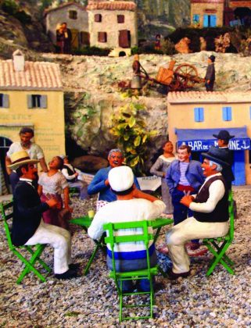
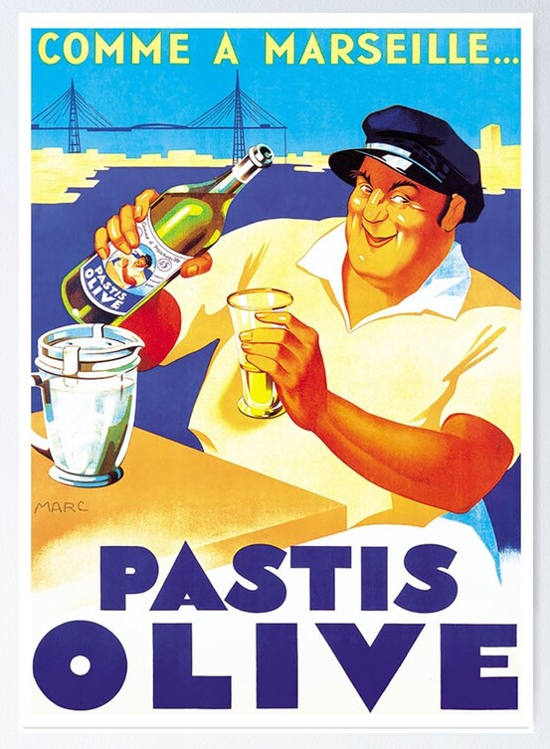
Provençal clichés

Slide 16
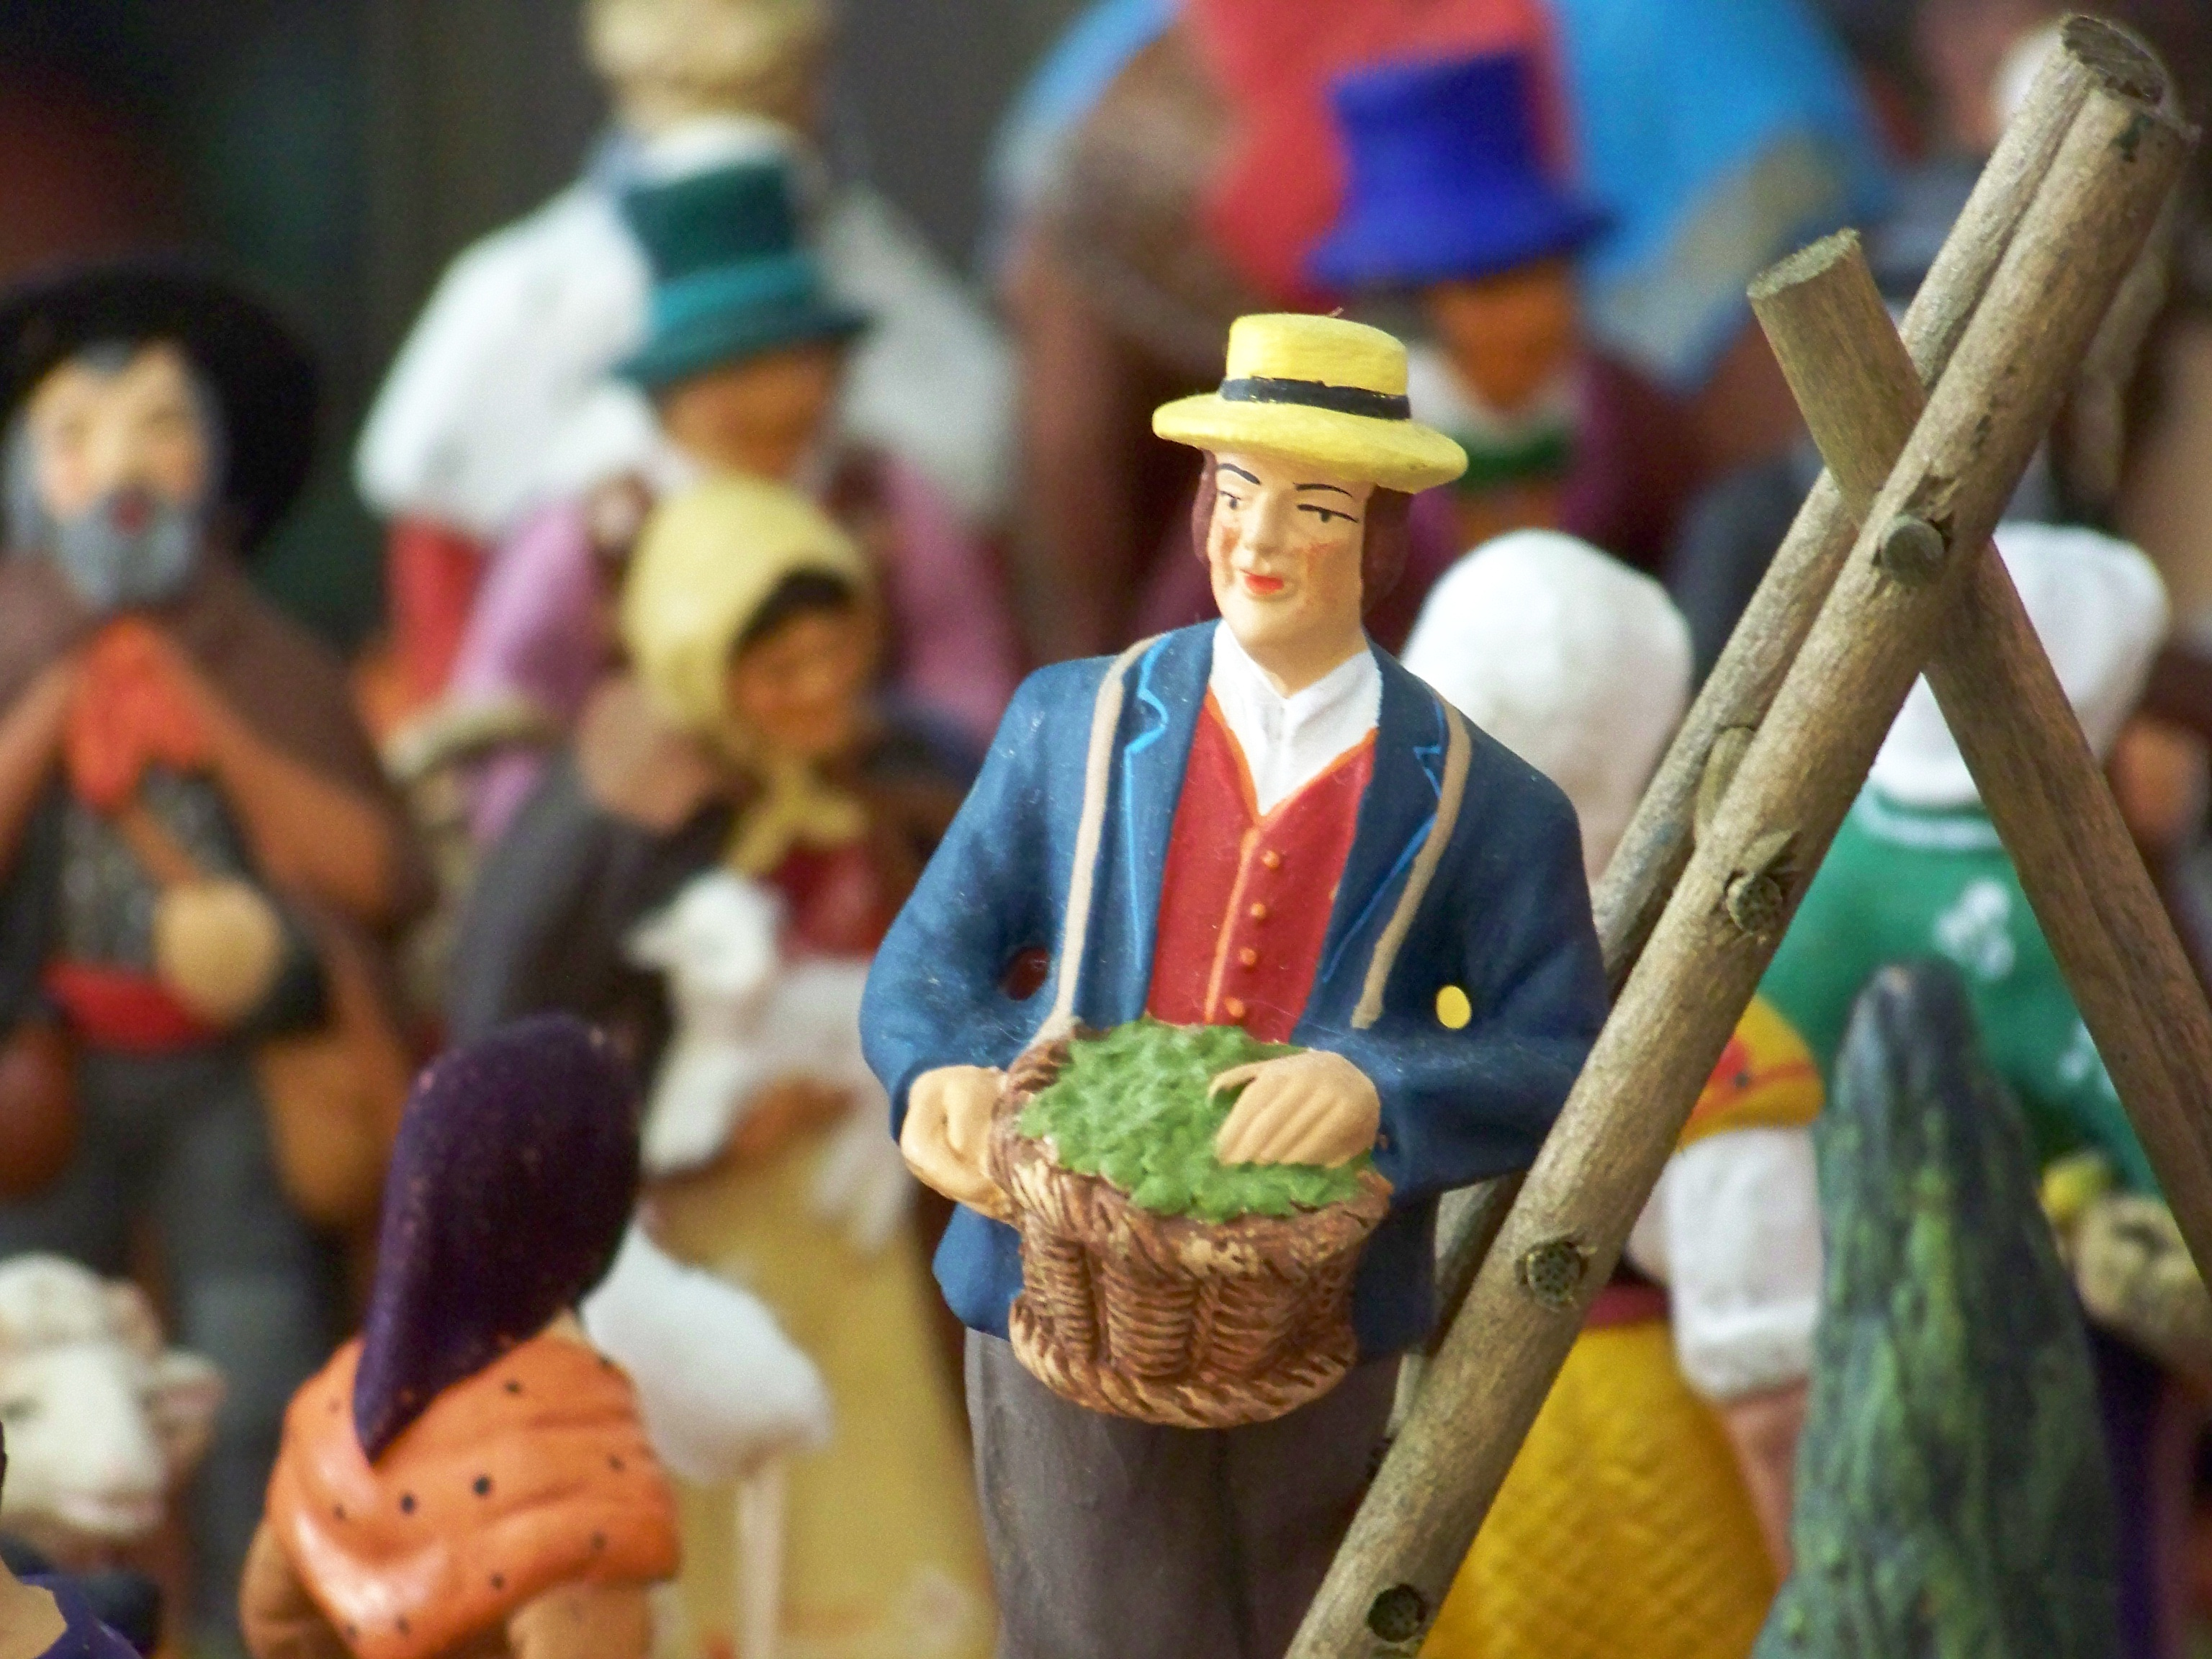
Santon
Loule – Mais vous voyez quand il n’a plus envie de jouer la comédie, quand il en a assez de faire rire, il sait plus quoi dire. Alors il se tait, il se sent bizarre, décalé.
[…] Et petit à petit, il s’anéantit vous voyez… Il crève à petit feu ! Il devient une sorte de santon, momifié.
Loule argues that Provençal culture and people are now out of place in their own land, and have become like a ‘santon’, a traditional local figurine that represents traditional Provençal villages, as in the previous slide and in this image:
Do you think Loule is justified in worrying about local culture?
Can you think of elements of Scottish culture that symbolise
Scotland but have little relevance to how we live today?

Slide 17
watch
Watch from 00:49:00-00:52:00
Video link here
From watching this sequence, how does the way the actors perform draw out both the gravity and the humour of the situations described?

Slide 18
Fiche de lecture
Update your fiche de lecture on the play.
Discuss what you can include with a partner or a group then share your ideas.

Slide 19
Character profiles
Update your character profiles based on what you have studied so far.
Discuss and share your ideas with others.

