Slide 1
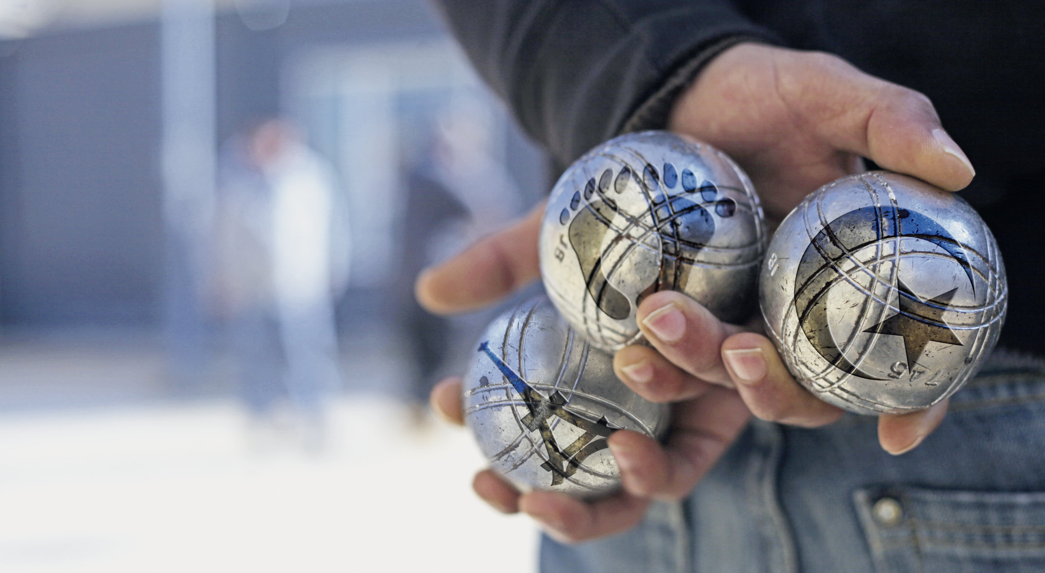
Remembering Empire
Les Pieds tanqués
Session 10

Slide 2
Les pieds tanqués (2012)
This session:
The play’s ending – pages 21-24 in the printable version of the play
Online sections 9-10.
Completing the fiche de lecture and character profiles
Brainstorming possible ideas for the portfolio essay.

Slide 3

Questions for discussion
From what you know so far:
Why do you think this is the marketing image? What do the symbols on the boules stand for? Can you explain the meaning behind the image?
What is the significance of the title Les Pieds tanqués ? Look at the footnote on your copy of the play.

Slide 4
Why do you think this is the marketing image? Can you explain the meaning behind the image?
The boules of pétanque are gathered together to be played against each other. Each one has a symbol of a particular group: the pieds-noirs (black feet), the mainland French (Tour Eiffel), and the Algerian people (Algerian flag). This reflects the clash of these cultures and memories that takes place in the play.
Why is the title Les Pieds tanqués ?
The title links to the idea of ‘fixed feet’. Literally, this refers to the position of the feet in a game of pétanque. Metaphorically, this refers to the idea of rootedness, the concept of belonging, and the right to land, all of which the characters debate.

Slide 5

Discuss:
How do personal experiences and Family memories impact the characters’ interpretations of history?

Slide 6
Non !
Read: page 22 from Monsieur Blanc – l'empire... to il a toujours survécu !
Watch: Video link here 55.15-58.00
How is Loule portrayed as isolated or in opposition to the other three characters in this scene?
What is the tone of Yaya and Zé's statements? Is it effective in persuading Loule?

Slide 7
Non !
How is Loule portrayed as isolated or in opposition to the other three characters in this scene?
While the others use longer sentences, Loule is only responding by shouting ‘non !’. In the recording, he has distanced himself by moving to another bench.
2. What is the tone of Yaya and Zé's statements? Is it effective in persuading Loule?
Yaya and Zé are speaking sarcastically to Loule. They imitate and mock his views and ways of expressing them. This further disengages and angers Loule.

Slide 8
Provence
Read to the end of p. 22:
Un temps. Yaya regarde Loule qui n’a pas bougé. Il se fait plus persuasif
Yaya - Oui survécu ! Parce que les tous les migrants et aussi les conquérants, y compris les Barons du Nord et aujourd’hui les promoteurs et les bétonneurs du monde entier… Tous ceux-là sont devenus des gens d’ici, malgré eux : les habitants d’une terre de paix, où la fraternité domine, où la douceur, l’élégance, l’amour l’ont toujours emporté sur le criard, le vulgaire, le violent.
Tous regardent Loule. Un temps.
Do you agree with this description of Provence and its history?

Slide 9
Play ending: A lost utopia?
Read: page 23 until ‘Ça serait pas beau ça ?’
Yaya (ramassant ses boules) – Si vous l’aviez eue plus, cette volonté qu’on apprenne, peut-être que vous auriez pu rester là-bas… Tu le croirais toi, ça, hein ? L’Algérie, un subtil mélange de Musulmans, de Chrétiens et de Juifs qui vivraient en paix, d’égal à égal : la plus belle et la plus grande des régions françaises, de l’Union européenne ! Ça serait pas beau ça ?
What is Yaya suggesting?

Slide 10
Play ending: A lost utopia?
What is Yaya suggesting?
Yaya suggests that if Algeria had not chosen independence, it could have been a utopic space where various religions lived in peace as the most beautiful region of France or even the EU. He argues that this was possible and would have been beautiful.
It is notable that this suggestion is made by Yaya, whose Algerian father fought for independence.

Slide 11
Play ending
Read:
Monsieur Blanc – Et si cette région elle existait déjà ? Si l’expérience d’Algérie, commencée en 1830, avait toutes les chances de réussir ici, en Provence, au xxie siècle. Comme une greffe qui aurait pris de ce côté-ci de la Méditerranée ?… Qu’est-ce que vous en pensez ? (tous le regardent pantois) Et vous, Loule, qu’est-ce que vous en dites ?
What does M. Blanc propose in response?

Slide 12
Play ending
M. Blanc argues that this utopia is still possible, but that it could instead be in Provence.
Do you agree with M. Blanc that Provence could be a harmonious space for diverse peoples to live in unity?
Why/why not?
Is this a utopian (impossible ideal) vision? Is it intended
as a possibility, or does it simply demonstrate the new
understanding between the characters?

Slide 13
Play ending
Watch: Video link here
58:25-59:40
How would you describe the physical and emotional reactions of the characters to this idea in this final scene?

Slide 14
Groupwork
In groups
Read and compare: pages 23 and 24 with pages 3 and 5:
How has the dialogue changed from before? What is similar and what is different?
Why?

Slide 15
Groupwork
Comparing pages 23-24 with pages 3 and 5.
Notice the repetition of:
T’as la mémoire courte
Vous venez d’arriver dans la région ?
On n’est pas bien tanqués ici, Monsieur Brun ?
Désintégrer
Nàri
Who says these lines now? Why has Chuyen done this?

Slide 16
Groupwork
Who says these lines now? Why has Chuyen done this?
The close of the play sees the characters repeat the play’s opening discussions, but subtly altered. Different people repeat each other's lines now. These changes reflect a new harmony and understanding between them.
The inclusion of the word ‘tanqués’ references the title of the play. There is a hopefulness in this ending, they play with the idea that they could all be rooted peacefully together in Provence.

Slide 17
Fiche de lecture
Update the fiche de lecture.
Discuss what you can include with a partner or a group then share your ideas.

Slide 18
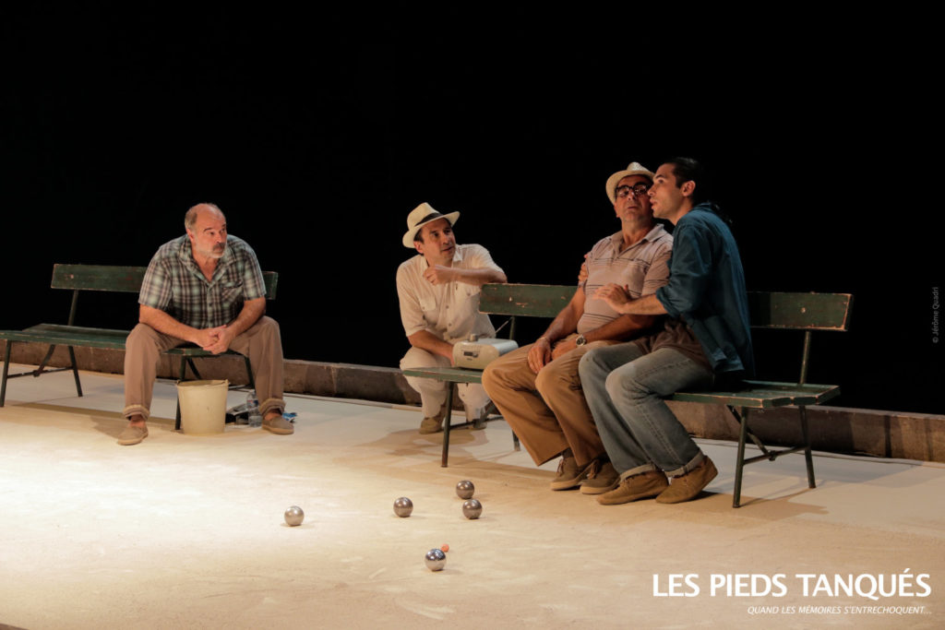
Character profiles
Update your character profiles based on what you have read this week.
Discuss what you can include with a partner or a group then share your ideas.

Slide 19
Portfolio
Brainstorm on possible ideas for the focus of your portfolio essay using your fiche de lecture
In pairs, discuss ideas you have had for your portfolio focus.

Slide 20
Portfolio
The next session will focus on approaches to writing your portfolio essay.
As preparation, you might like to consider this possible title:
'To what extent does Les Pieds Tanqués conform to the model of 'competitive memory' in its representation of the Algerian War and how is this demonstrated in the play?

