Slide 1
Introducing ‘Remembering Empire’

Slide 2
WELCOME TO REMEMBERING EMPIRE!

Slide 3
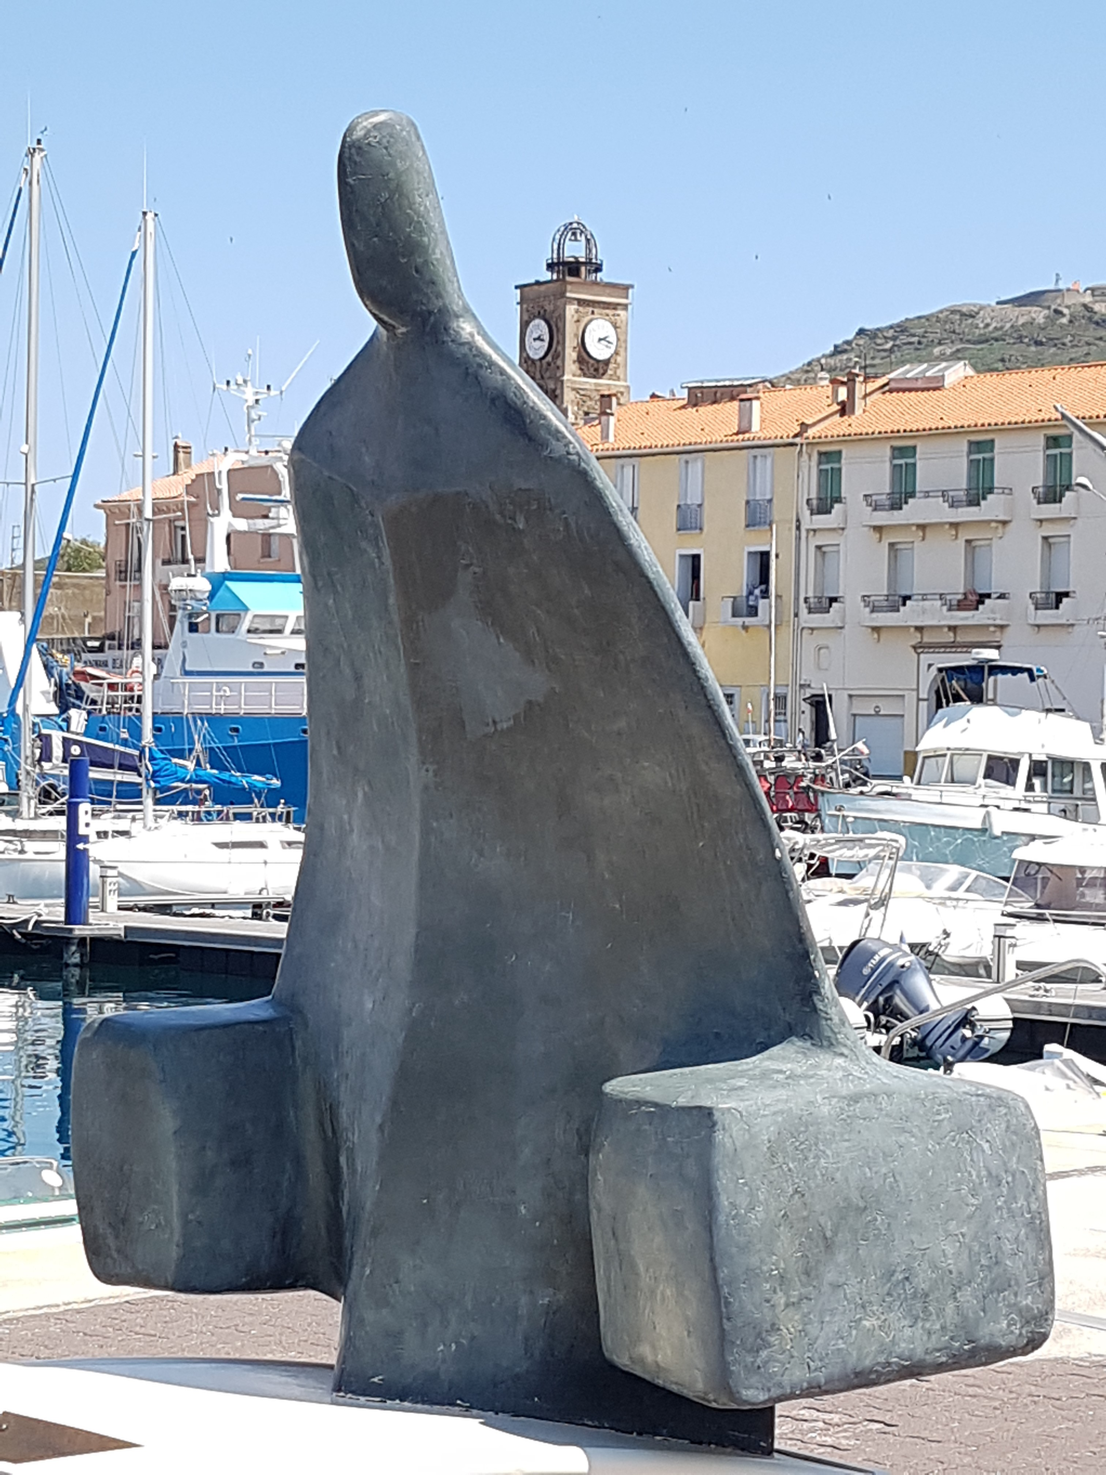
Introduction
This session asks why people leave their home country and travel to another country.
We will look at
Emigrants
Settlers
Immigrants
Refugees

Slide 4
Forced to travel?
Today and throughout history, many people leave their homes to seek new lives elsewhere.
Why might people choose to leave their homes?
Want a better life
Want to live in a different country
War
Poverty

Slide 5
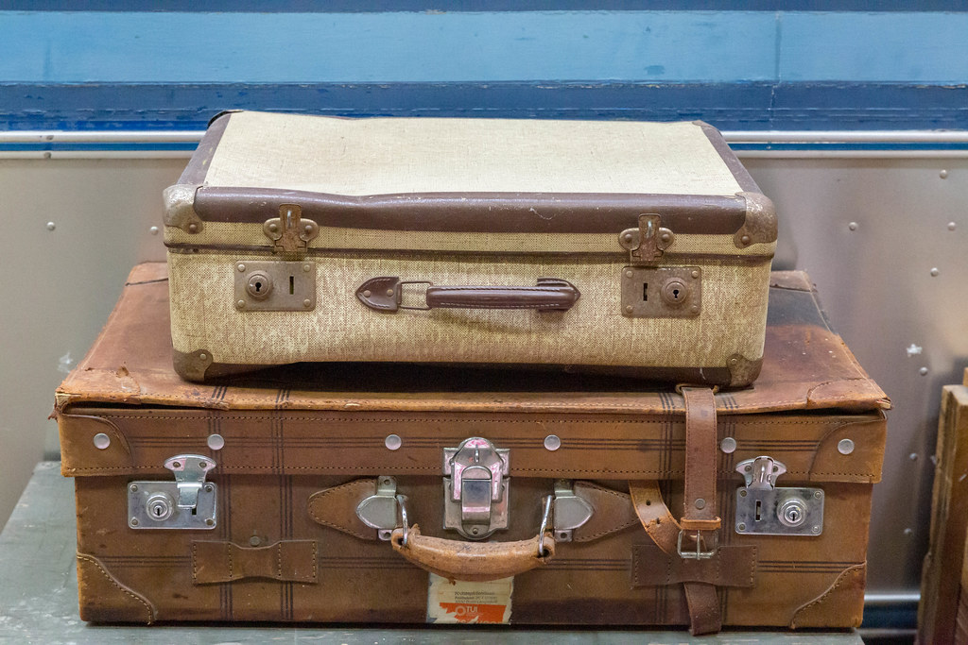
Leaving home
How would you feel if you were leaving your home?
Excited?
Scared?
Anxious?
Often it depends why you are leaving.

Slide 6
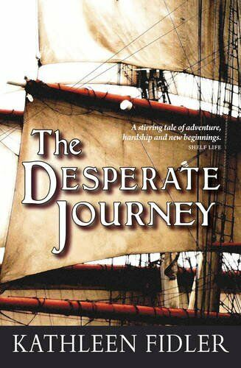
The Highland clearances
In 18th century Scotland, many people lived in small crofts, rented from rich landowners
When the landowners decided that they could make more money from farming sheep, the people were forced to leave their crofts
Many moved to work in cities like Glasgow
Others emigrated to start new lives in America and Canada.
You can read about this in books like The Desperate Journey.

Slide 7
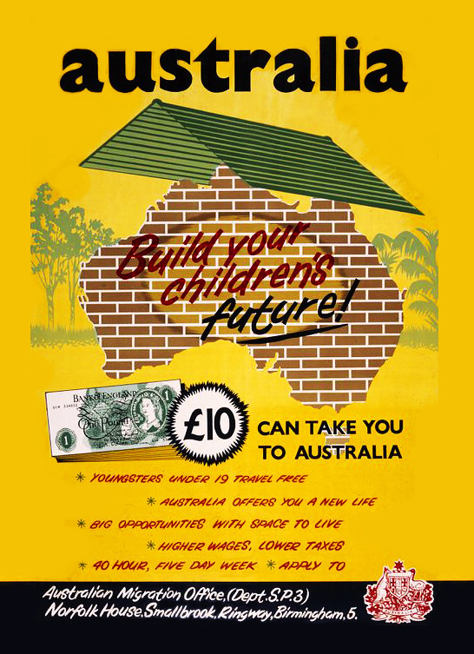
Emigration
Leaving your country to start a new life in another country is called ‘emigration’.
The people who left Scotland after the Highland Clearances were emigrants.
More recently, in the 1950s lots of people left the UK to start a new life in Australia. They bought a ticket to Australia for £10, so they were known as ‘ten pound Poms’. (A Pom is a word for someone from the UK).

Slide 8
colonisation
When we talk about emigration, we think about how the people leaving their homes felt.
But the countries that they arrived in were not empty. They already had people living there. Those indigenous (or native) people were treated very badly by the arriving emigrants. Many were killed and their way of life was destroyed. We should also think about how those people felt.
E

Slide 9
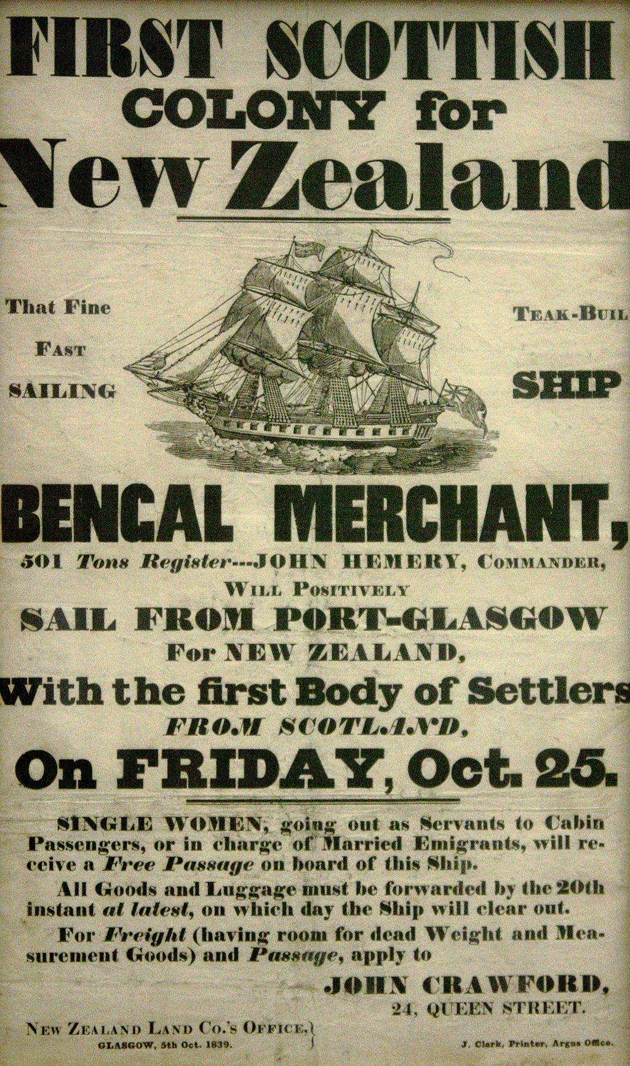
Colonisation
Emigrants from the UK went to countries like Canada, America, Australia and New Zealand. Those countries were colonised by the UK. That means that they belonged to the UK, which controlled them and the people who lived there.
There was no equality in colonised countries. The British people who arrived in these countries had more rights than the native Americans or Aboriginal peoples who lived there.

Slide 10
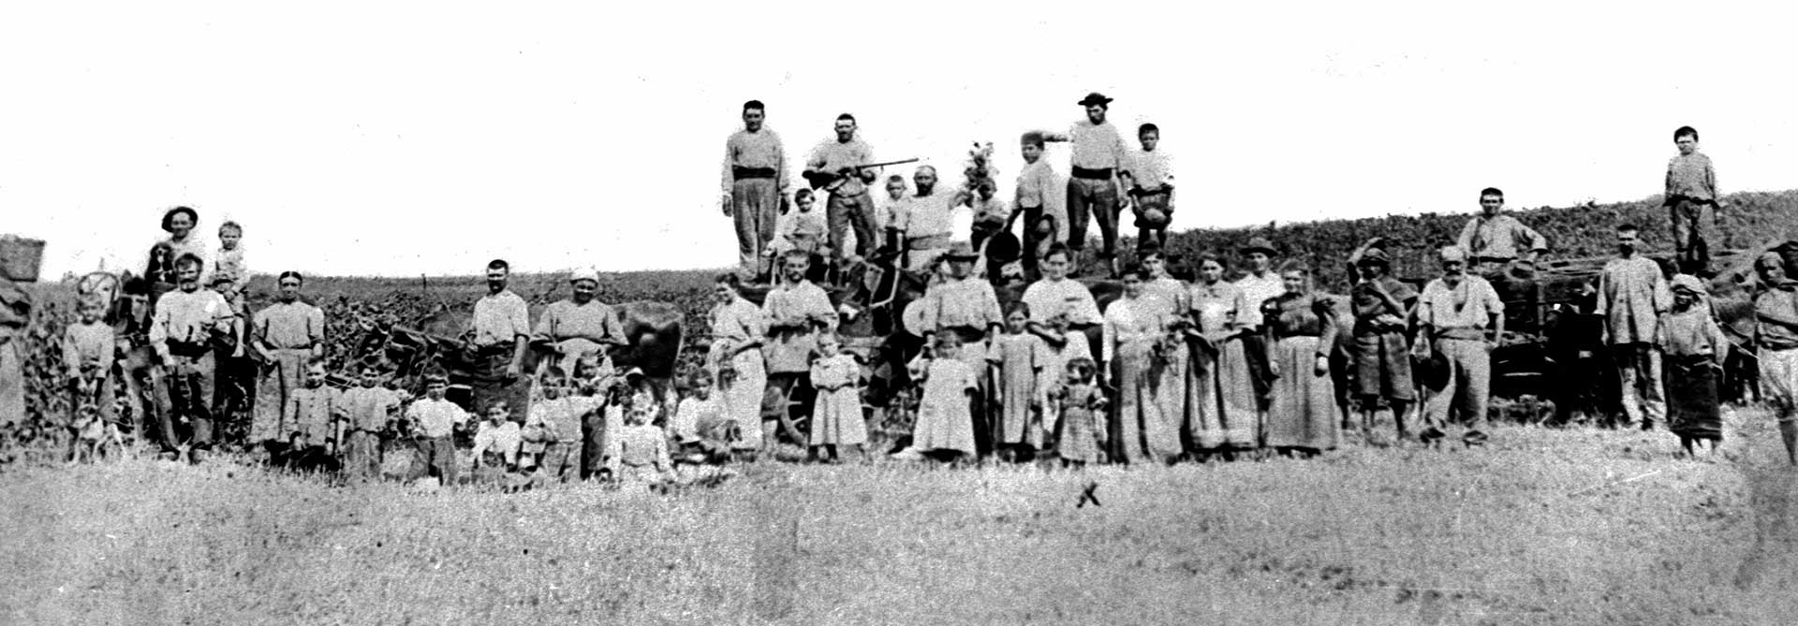
settlers
When they arrived, the emigrants were given land that had belonged to the native peoples.
The emigrants built houses and farms. They stayed and became known as settlers. They built the modern nations of USA, Canada and others. They were the most powerful group. The indigenous (or native) peoples did not have the same rights as the settlers.
How do you think the indigenous peoples felt about people arriving and settling on their land?

Slide 11
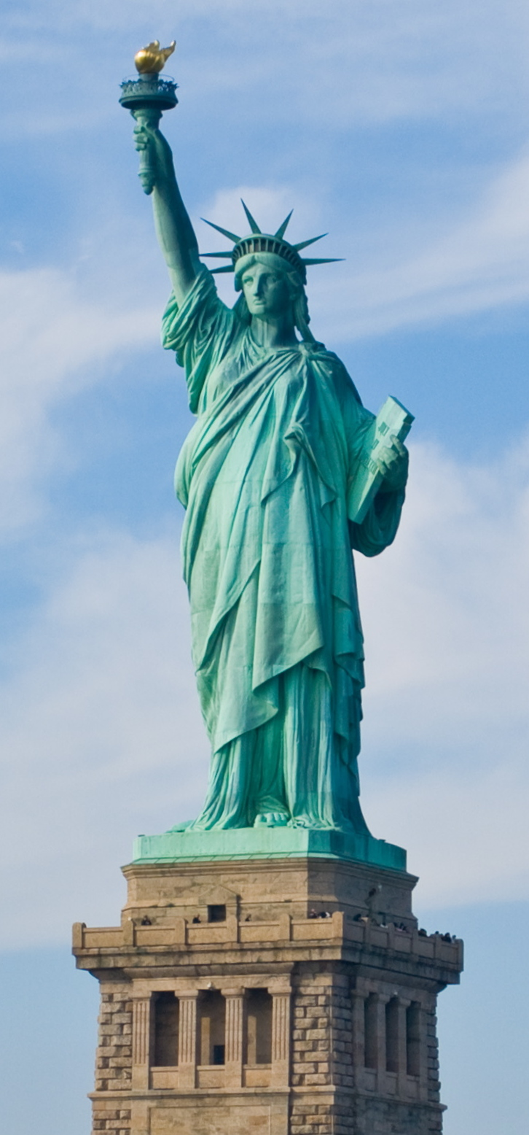
IMMIGRANTS
The word ‘immigrant’ is used to describe someone who has moved permanently to another country to find work.
While settlers belong to the group that holds power in the country, immigrants usually have less power. They may be treated as different because they are from a different culture, race or religion.
What words are sometimes used to describe immigrants?
Hard-working Illegal
Determined Scroungers
The Statue of Liberty in New York welcomes immigrants arriving in America for the first time.

Slide 12
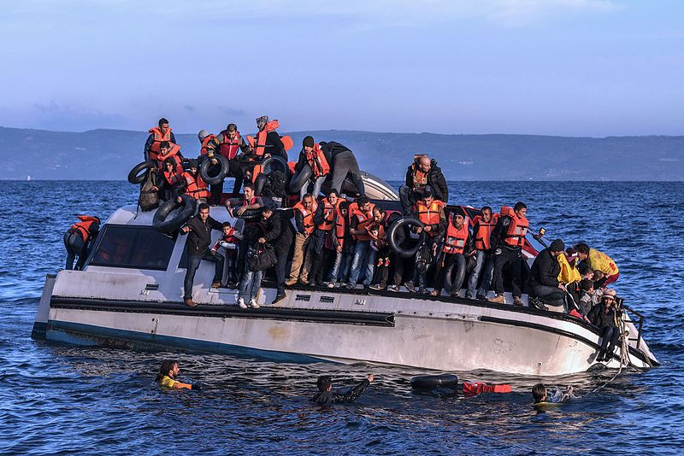
refugees
A refugee is someone who has fled their country because of fear of violence.
Under the 1951 Refugee Convention they have the right to claim asylum (safety) in a safe country. Safe countries, like the UK, have an obligation to give them protection.
Refugees are often referred to as ‘illegal immigrants’, despite the fact that they have a right to refuge
How should we treat people who arrive in the UK seeking refuge?

Slide 13
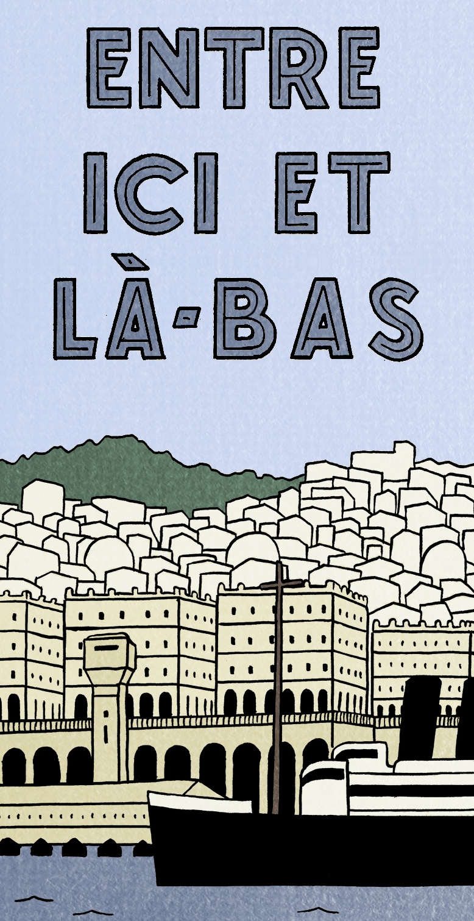
From settlers to refugees
As we have seen, emigrants, settlers, immigrants and refugees all leave one country and move to live in another. But some groups have more power than others. Sometimes one person can be part of a powerful group which makes other people suffer, and then, because of events, they become part of another, weaker group.
Like the UK, France also had an empire. In these sessions we will look at the story of a French girl, Jeanne, who comes from a family of settlers. Jeanne’s family have settled in Algeria, which used to belong to France.
When Algeria becomes an independent country after a long war Jeanne’s family have to flee like refugees to safety in France.

