Slide 1
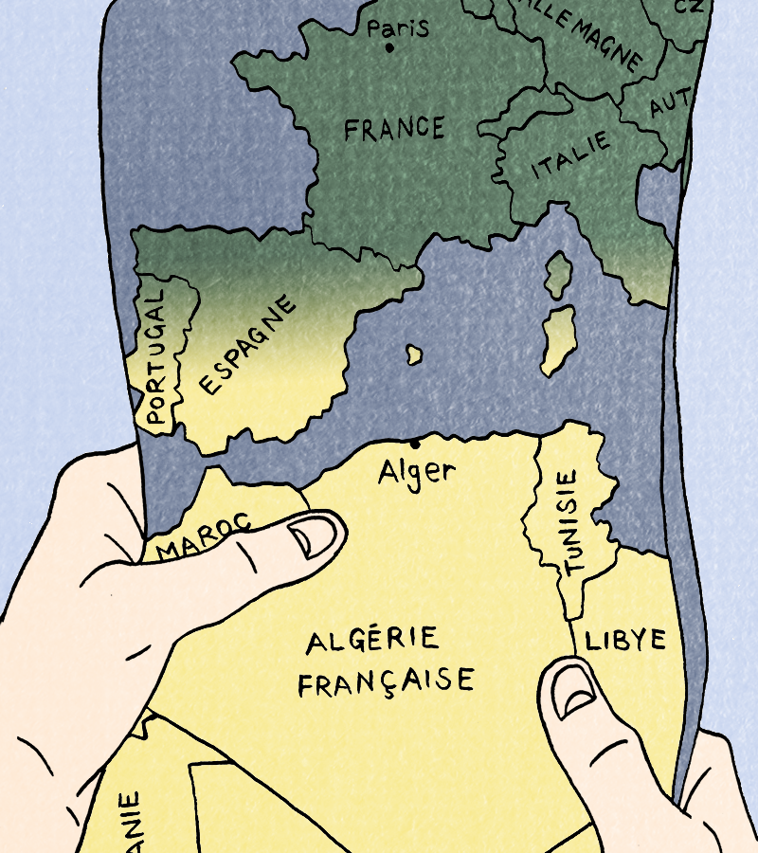
Session 5

Slide 2
activities and language points
We will:
Do some fun activities to practise our new words and to reflect on what we have learnt about Algeria and France!
Practise asking questions
Practise speaking about emotions
Practise thinking about the future

Slide 3
Fais ta valise !
Packing suitcase role play:
Get into groups of 2-3.
One pupil will be Jeanne and 1-2 will be her parent(s) .
Parents: ask Jeanne what she will put in her suitcase. You can give ideas for what she can include from your activity sheet and use gestures / charades to help your ‘Jeanne’ understand!
Jeanne: say what you do and don’t want in your suitcase. You can use your activity sheet for possible answers and can also use charades.
Some sample sentences are on the next slide and your activity sheet.
What next? Change roles as you role play

Slide 4
Parents
Jeanne
Est-ce que tu veux… | Do you want…
Tu veux …
Veux-tu…
Oui, je veux… | Yes, I want…
Non, je ne veux pas… | No, I do not want…
Je ne sais pas | I don’t know
un livre | a book
un jouet | a toy
de l’argent | some money
un sandwich | a sandwich
un manteau | a coat
un pantalon | trousers
des medicaments | some medicine
le chien | the dog

Slide 5
Les Sentiments
Emotions roleplay
Get into groups of 2-4. One pupil will be Jeanne’s grandfather and 1-3 will be his worker(s) on the farm.
Jeanne’s grandfather: do a charade for your emotions when you think about the farm that the government has given you and your local workers. The others will guess which emotion it is (in French)!
Workers: do charades to show how you feel working hard on the farm for Jeanne’s family on the land you used to own. The others will guess which emotion it is (in French)!
You can also act out some emotions that were not in the comic. Use the activity sheet vocabulary to help!

Slide 6
Les sentiments
Je suis… | I am… + emotion from image:
J’aime la ferme | I like the farm
Je n’aime pas la ferme | I do not like the farm
Vous êtes comme ma famille | You are like my family

Slide 7
L’Avenir
Imagine Omar grows up and moves to France to find work.
What will happen next?
Using ideas from your activity sheet, imagine what you think will happen next now that Omar has arrived in France.
Think about how he will be treated and how his life may change.
When ready, you will act out your ideas to each other in groups.
They will guess which answers you have chosen in French from your charades.
The ideas on the next slide and on your activity sheet (in English and French) can be used to help you:

Slide 8
 | Option 1 | Option 2 | Option 3
Le temps en France | Il fait chaud | Il pleut | Il fait froid
Chez moi | J’ai un petit studio | Je partage un appartement avec deux autres | J’habite chez des amis
Le travail | Je travaille au marché | Je cherche un travail | Je travaille le soir dans un restaurant
La ville | Est belle | Est chère | Est grande
J’aime | La nourriture | Les parcs | Les monuments
Je n’aime pas | Me perdre dans la ville | Me sentir seul | Travailler tous les jours
Je veux | Un bon appartement | Des amis | Trouver un bon travail

