Slide 1
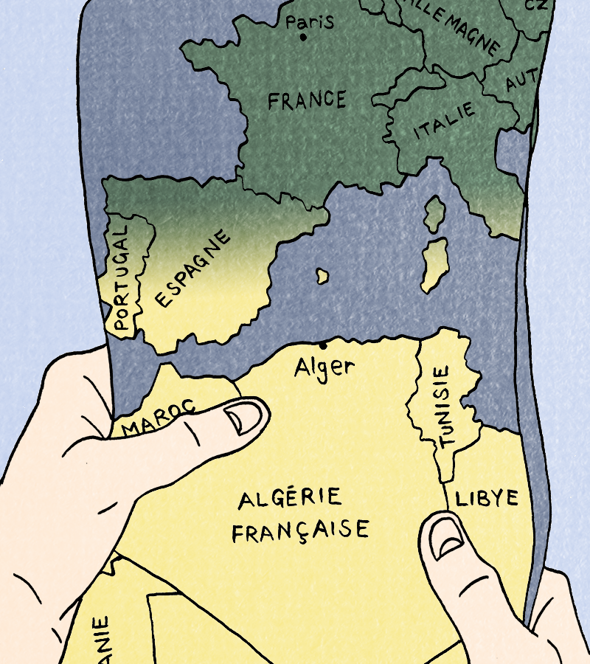
Session 4

Slide 2
Today’s language points
Using the near future (aller + infinitive) to say:
I am going to do (something)
Je vais faire (quelque chose)
This allows us to talk about things that are going to happen in the future.

Slide 3
Today
We will:
Do a quiz
Read the next sections of our comic
Focus back on the quayside, where Jeanne’s family is about to depart on the boat for France.
Practise talking about the future

Slide 4
Vrai ou Faux ?
1. Jeanne habite en Algérie. Jeanne lives in Algeria
2. Jeanne et sa famille habitent à la montagne. Jeanne and her family live in the mountains
3. Omar dit que les Arabes veulent l’indépendance. Omar says the Arabs want independence
4. La ville d’Alger est dangereuse à cause de la guerre. The city of Algiers is dangerous because of the war
5. La famille de Jeanne est contente. Jeanne's family is happy
6. Les écoles sont ouvertes. The schools are open
7. Le gouvernement français signe un accord avec les Arabes pour finir la guerre. The French government signs an agreement with the Arabs to end the war.
8. Jeanne et sa famille doivent quitter l’Algérie pour la France. Jeanne and her family must leave Algeria for France

Slide 5
Vrai ou Faux ?
Activity 1. Vrai ou faux ?
1. Jeanne habite en Algérie. VRAI
2. Jeanne et sa famille habitent à la montagne. FAUX
3. Omar dit que les Arabes veulent l’indépendance. VRAI
4. La ville d’Alger est dangereuse à cause de la guerre. VRAI
5. La famille de Jeanne est contente. FAUX
6. Les écoles sont ouvertes. FAUX
7. Le gouvernement français signe un accord avec les Arabes. VRAI
8. Jeanne et sa famille doivent quitter l’Algérie pour la France. VRAI

Slide 6
Entre ici et là-bas
Task: Let’s read our final pages!
Start from ‘Les écoles ferment’ (the schools close) and read to
'on doit partir aussi’ (we need to leave too).

Slide 7
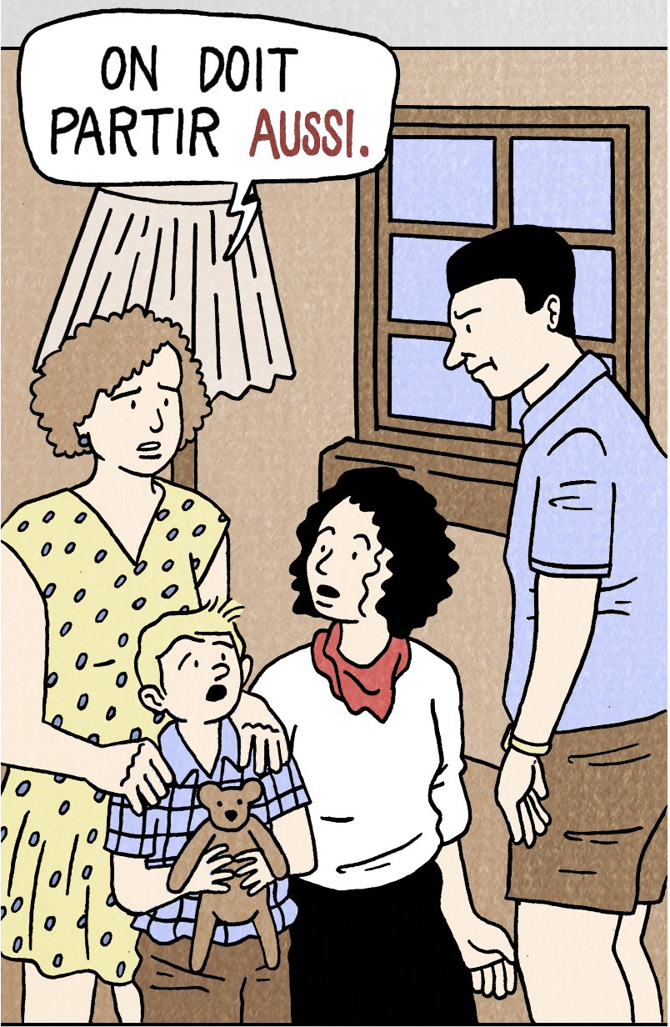
Entre ici et là-bas
In this section we learn that French settler families are leaving.
Why?

Slide 8
Entre ici et là-bas
It is no longer safe for French families.
Despite a ceasefire there is still a lot of violence.
Because they are French citizens, they are allowed to ‘return’ to mainland France, but many of them have never actually lived there!

Slide 9
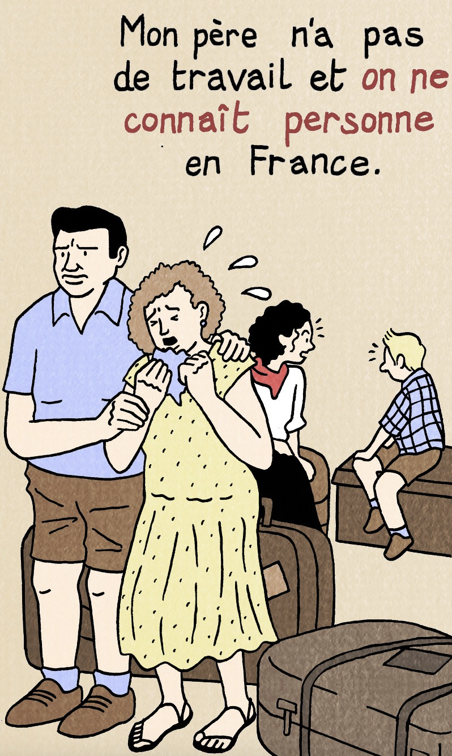
Entre ici et là-bas
Now read from ‘Beaucoup de familles ont peur’ (lots of families are scared) until
'on est comme des réfugiés' (we are like refugees).
What is Jeanne worried about ? Do you think she is right to worry?
Now read to the end.

Slide 10
Life as a refugee - Jeanne
Jeanne has had to flee Algeria and will be like a refugee in France. What do you understand by the word 'refugee'?*
How should Jeanne be treated in France, as someone who is fleeing conflict?
How do you think that she will be treated France?
How do you think she will feel?
*The United Nations says, 'Refugees are people who have been forced to flee their homes and have crossed an international border to find safety in another country.'

Slide 11
Activity 2
Using your Activity Pack, match the sentences to the images.
1. Au début, Jeanne et sa famille sont au port en Algérie. In the beginning, Jeanne and her family are at the port in Algeria
2. Jeanne parle de sa famille. Le gouvernement français a donné une ferme à son arrière-grand-père. Les Arabes travaillent pour la famille. Jeanne talks about her family. The French government gave a farm to her great-grandfather. The Arabs worked for the family.
3. Les Arabes sont en colère parce que la terre leur appartenait avant. The Arabs are angry because the land was theirs before the French arrived.
4. Jeanne a une bonne vie, mais son ami arabe Omar a une vie difficile. Jeanne has a good life but her Arab friend Omar has a difficult life.

Slide 12
Activity 2
5. Les Arabes et les Français sont en conflit. Il y a des bombes dans la ville. Jeanne a peur. The Arabs and the French are at war. There are bombs in the city. Jeanne is scared.
6. Le gouvernement signe un accord avec les Arabes pour finir la guerre. The French government signs an agreement with the Arabs to end the war.
7. La famille de Jeanne doit partir pour la France parce que c’est dangereux. Ils ne veulent pas quitter L’Algérie. Jeanne's family has to leave to France because it is dangerous. They don't want to leave.

Slide 13
Life as an immigrant - Omar
Imagine that Omar moves to France in ten years to find work.
If Omar moves to France as an immigrant how will he be treated?
How are immigrants often treated?
How will he feel?
How should we treat immigrants?

Slide 14
Not all new arrivals are treated the same
Do you think there will be a difference between how Jeanne is treated and how Omar is treated in France? Do you think it will make a difference that Jeanne is a white refugee from a French family and that Omar is an Arab immigrant? Don’t forget that the Algerians fought against the French to become independent. Will that matter?

Slide 15
What will happen next?
Using aller + infinitive, say what is going to happen (e.g. Jeanne is going to…)
On your activity sheet, join up the sentences to make future statements about what might happen next. There might be more than one possible answer – you choose what happens! Write them out in their completed form and translate them into English.
1. Jeanne va…
2. Omar va…
3. Les parents de Jeanne vont…
5. Les Algériens vont…
a. rester en Algérie
b. déménager en France
c. rester en contact avec Omar/Jeanne
d. trouver un travail en France
e. vivre avec sa famille en Algérie
f. être content(e)(s)
g. être triste(s)

