Slide 1
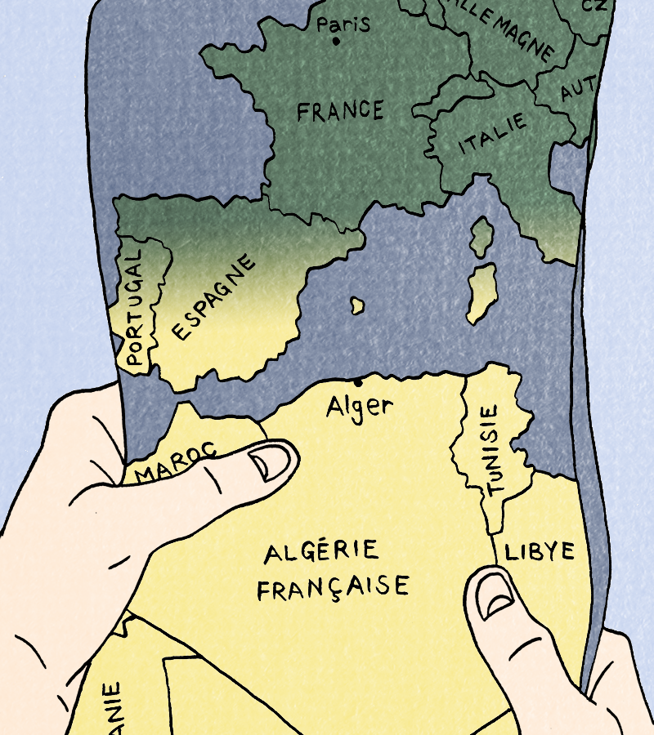
Session 3

Slide 2
Today’s language points
Describing daily routines
Using common verbs in the present tense

Slide 3
Today
We will:
Read the next section of our comic book
Focus on experiences of the War of Independence in Algeria.
Practise talking about our daily lives in French
What do you remember so far: Who are our characters and where are they? Why?

Slide 4
Entre ici et là-bas
Task: Let’s read the next section !
Read from 'ma mère s'est mariée avec mon père' (my mum married my dad) to
'j'aime aller à la plage’ (I like the beach).
Here we start to hear about Jeanne’s life in Algeria.

Slide 5
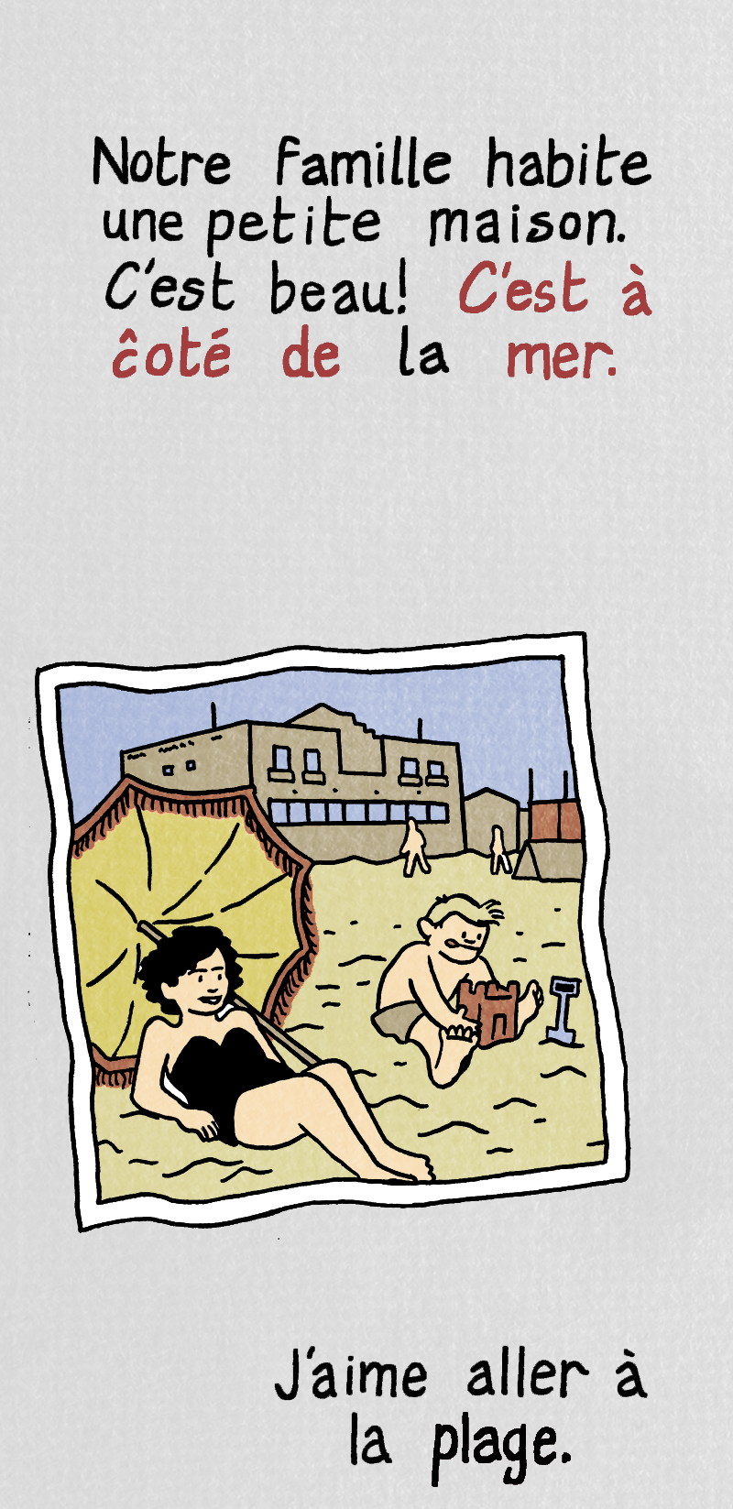
Entre ici et là-bas
In this section we learn that Jeanne is from a family of settlers.
Where does she live? What does she like to do?
Now read the next section from 'Je ne veux pas partir' (I don't want to leave) to
'on veut l'indépendence' (we want independence).

Slide 6
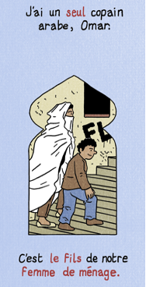
Entre ici et là-bas
In the next section we learn that Jeanne’s friend, Omar, is from a local Arab family living in the Casbah.
What is his life like?
How different do you think Omar and Jeanne's lives are? How similar?

Slide 7
Omar et Jeanne
Using what you can see in this section and your own imagination, describe Jeanne's and Omar’s lives.
You can make suggestions in French or English and your tutor will write in French on the board.
Examples and a template are on the next slide and your activity book:

Slide 8
Useful verbs
You may find some of the following verbs useful
Verbs ending in –er
jouer (to play); manger (to eat); aider (to help)
- Elle joue; il mange; elle aide;
Irregular verbs:
faire (to make/do); aller (to go); être (to be)
- Il fait; elle va; il est

Slide 9
 | Jeanne | Omar
Le matin | Example : Jeanne mange du pain avec de la confiture. Elle joue avec son chien. Jeanne eats some bread and jam. She plays with her dog.
L'après-midi |  | Example : Omar va chez Jeanne avec sa mère. Sa mère fait le ménage. Il aide sa mère. Omar goes to Jeanne’s house with his mum. His mum does the cleaning there. He helps his mum.
Le soir | Jeanne joue avec Omar. Jeanne plays with Omar.
La maison |  | Example : Omar partage une chambre avec sa mère et son frère. Omar shares a bedroom with his mother and brother.
L'école | Jeanne va à l’école. Jeanne goes to school.
Le quartier

Slide 10
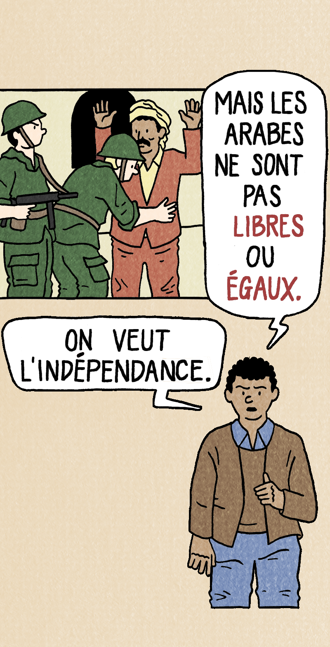
Now, compare the differences and similarities.
What do they both share in common?
When you compare the differences between Jeanne’s and Omar’s lives, does this seem fair?

Slide 11
La Guerre
Let’s read the next section. The war has started.
Read from 'il y a des bombes en ville' to
'mais la violence continue'.
Why is Jeanne scared?
Can you see examples of things that might scare her as we read?

Slide 12
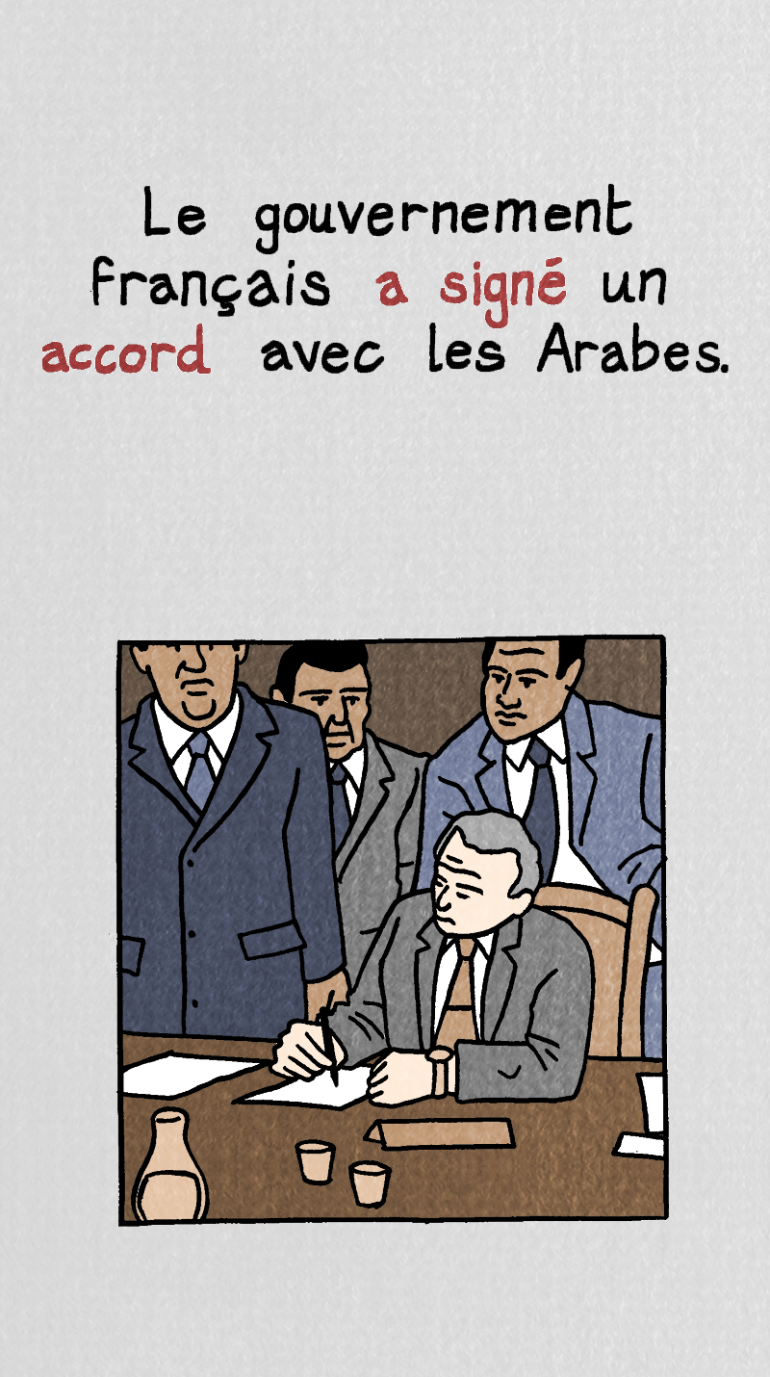
L’Indépendance
Algeria had been legally part of France since 1848. The war made the French government realize it could not continue to govern Algeria.
President Charles de Gaulle decided to let Algerians vote to choose to stay part of France or become independent.
In 1962, Algeria chose to become independent from France.

Slide 13
L’Indépendance
How would different people react to the news of independence?
Imagine it from the point of view of as many characters as possible.
Characters include:
Jeanne
Jeanne’s parents
Omar
Omar’s mother
Arabs working on French farms

Slide 14
Entre ici et là-bas
Task: Let’s see what you remember using a quiz!
A question may have more than one right answer.

Slide 15
What does the book’s name, Entre ici et là-bas, mean? | Enter Here and There | Between Here and There | Enter the Ice and Label
2) Where are Jeanne and her brother when we first meet them? | At home | In France | At the harbour in Algeria
3) Why are they leaving Algeria? | It’s too dangerous | It’s too expensive | It’s too hot
4) Who could not go with them? | Their family | Their dog | Their mum
5) Who was the first person in Jeanne’s family to move to Algeria? | Her dad | Her grandad | Her great-grandad
6) What did he do there? | Fought in the army | Built a farm | Joined the government
7) Why were some Algerians unhappy? | They were very poor | They had lost their land to the French | They were beaten if they didn’t work hard enough
8) Why did the war begin? | Because Algerians wanted to go to France | Because the French army wanted to stay in Algeria | Because Algerians wanted independence
9) How did the war end? | An agreement was signed | With a huge battle | Algeria surrendered
10) How does Jeanne feel about going to France? | Excited | Worried | Happy

Slide 16
1) What does the book’s name, Entre ici et là-bas, mean? | Enter Here and There | Between Here and There | Enter the Ice and Label
2) Where are Jeanne and her brother when we first meet them? | At home | In France | At the harbour in Algeria
3) Why are they leaving Algeria? | It’s too dangerous | It’s too expensive | It’s too hot
4) Who could not go with them? | Their family | Their dog | Their mum
5) Who was the first person in Jeanne’s family to move to Algeria? | Her dad | Her grandad | Her great-grandad
6) What did he do there? | Fought in the army | Built a farm | Joined the government
7) Why were some Algerians unhappy? | They were very poor | They had lost their land to the French | They were beaten if they didn’t work hard enough
8) Why did the war begin? | Because Algerians wanted to go to France | Because the French army wanted to stay in Algeria | Because Algerians wanted independence
9) How did the war end? | An agreement was signed | With a huge battle | Algeria surrendered
10) How does Jeanne feel about going to France? | Excited | Worried | Happy

Slide 17
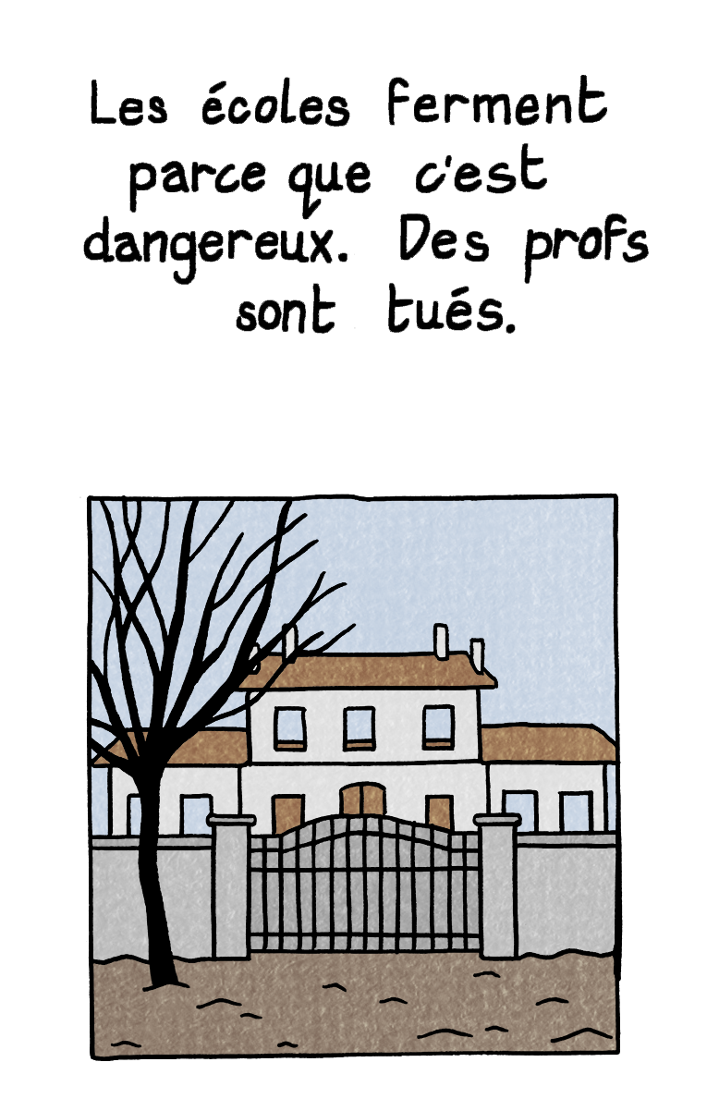
Les écoles ferment
What do you think life was like when the schools closed in Algeria? How would the children have felt when the schools closed? How did you feel when your school closed during the Covid pandemic?

