Slide 1

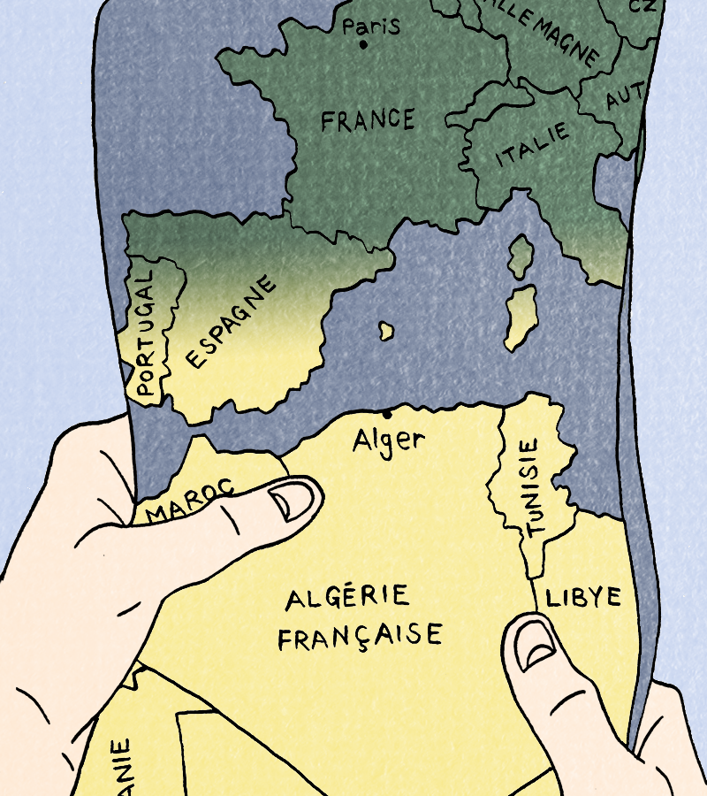
Session 2

Slide 2
Today's language points
Describe our emotions in French
Use être in the present tense

Slide 3
Today's content
We will:
Learn more about Jeanne’s family, starting with her great-grandfather. We will hear about how they first settled in Algeria and why.
Read the next part of our comic book together.
Discuss new terms: 'settler', 'immigrant' and 'refugee'

Slide 4
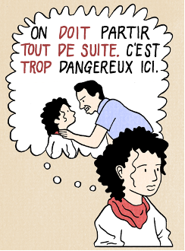
Recap Last week
Last time we learned about Jeanne’s family. What are they doing, and why?
Look back at the first part of the comic to help you.

Slide 5
Last Session
A young girl called Jeanne and her family are in Algeria before they move to France.
They are leaving in a hurry and are worried while they wait for a boat.
They couldn't pack everything they wanted and had to leave their dog and friends behind.

Slide 6
Discuss
We talked last time about why people might leave their own country to start a new life elsewhere.
Why might people do that?

Slide 7
Entre ici et là-bas
Task: Let’s read the next part of the comic!
Read from 'Mon arrière-grand-père est venu' (My great-grandad came) to
'le gouvernement a donné une ferme' (the government gave a farm)

Slide 8
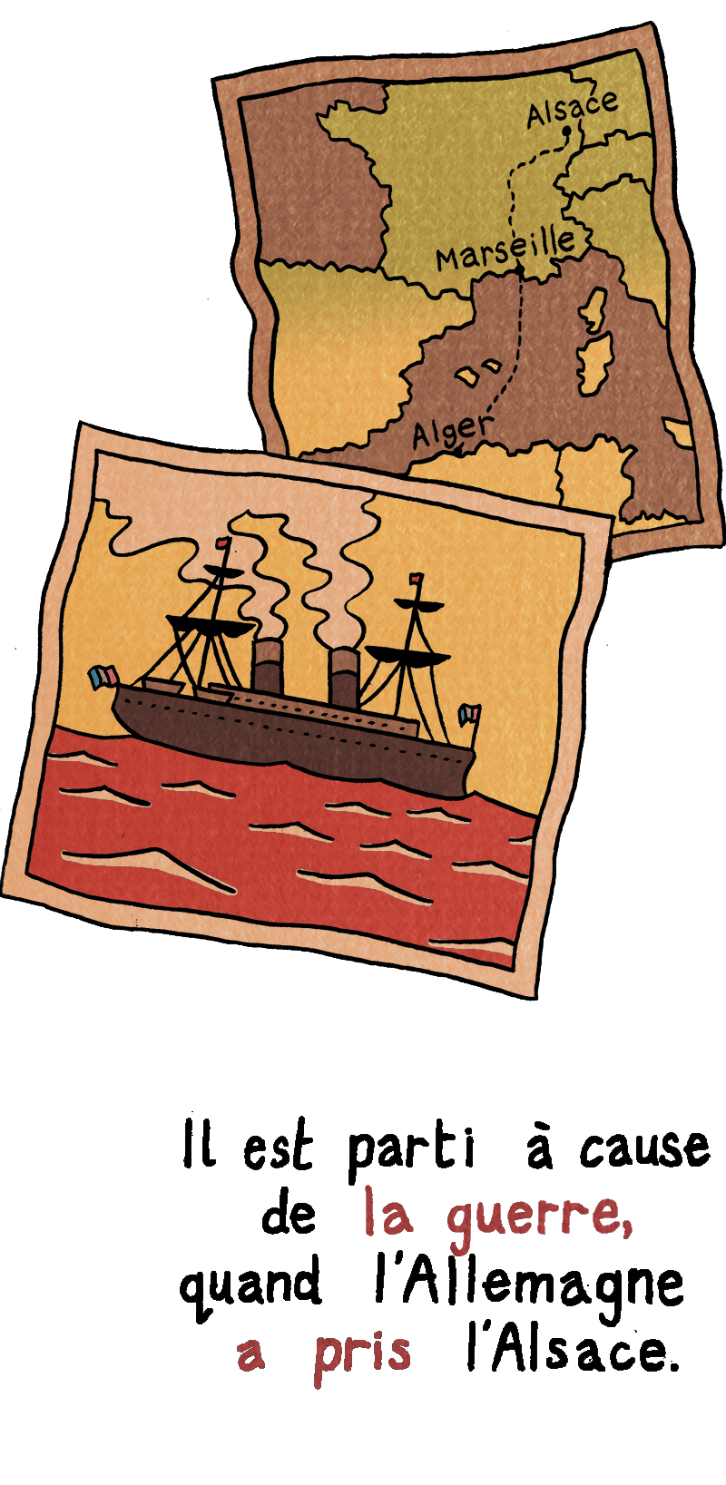
Background history
In 1870, Germany invaded the east of France and took control of the region of Alsace.
Some of the people living there decided to leave rather than live under German rule.
Jeanne’s great-grandfather was one of these people.
The French government was encouraging people to settle in Algeria, which then belonged to France, and so he decided to seek a new life on the other side of the Mediterranean Sea.

Slide 9
Do you know the word ‘settler’?

Slide 10
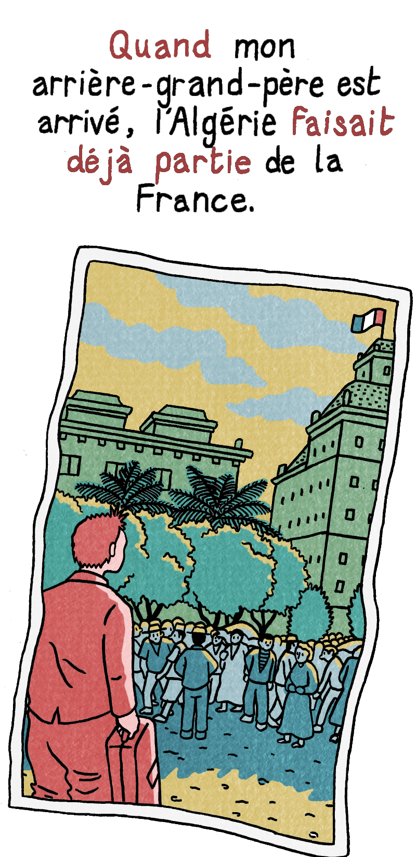
Settlers
We will use this word in our sessions.
Settlers are people who have moved from one country to live in another part of the world, often a place that belongs to their country or is part of their country's empire.
In our story, Jeanne’s great-grandfather is an example of a settler when he moves to Algeria as at that time Algeria was part of France's empire.
When he arrives in Algeria, he is given farmland by the French government.

Slide 11
We have many words for people who come from different countries.
We might talk about settlers (colons), or immigrants (immigrés), or refugees (réfugiés).
Can you think of the differences between these terms?

Slide 12
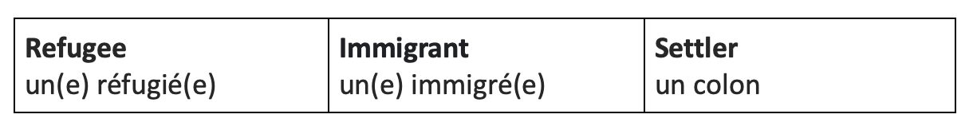
Task: Match the definition to the right word on your activity sheet

Slide 13
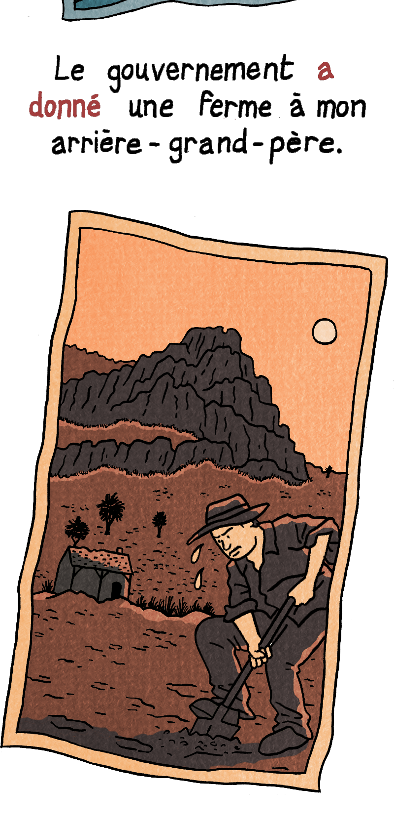
Jeanne’s great-grandfather is an example of a settler when he emigrates from France to Algeria.
When he arrives in Algeria, he is given farmland by the French government.
Do you think he is happy to have the farmland?
Who do you think the farmland belonged to before?

Slide 14
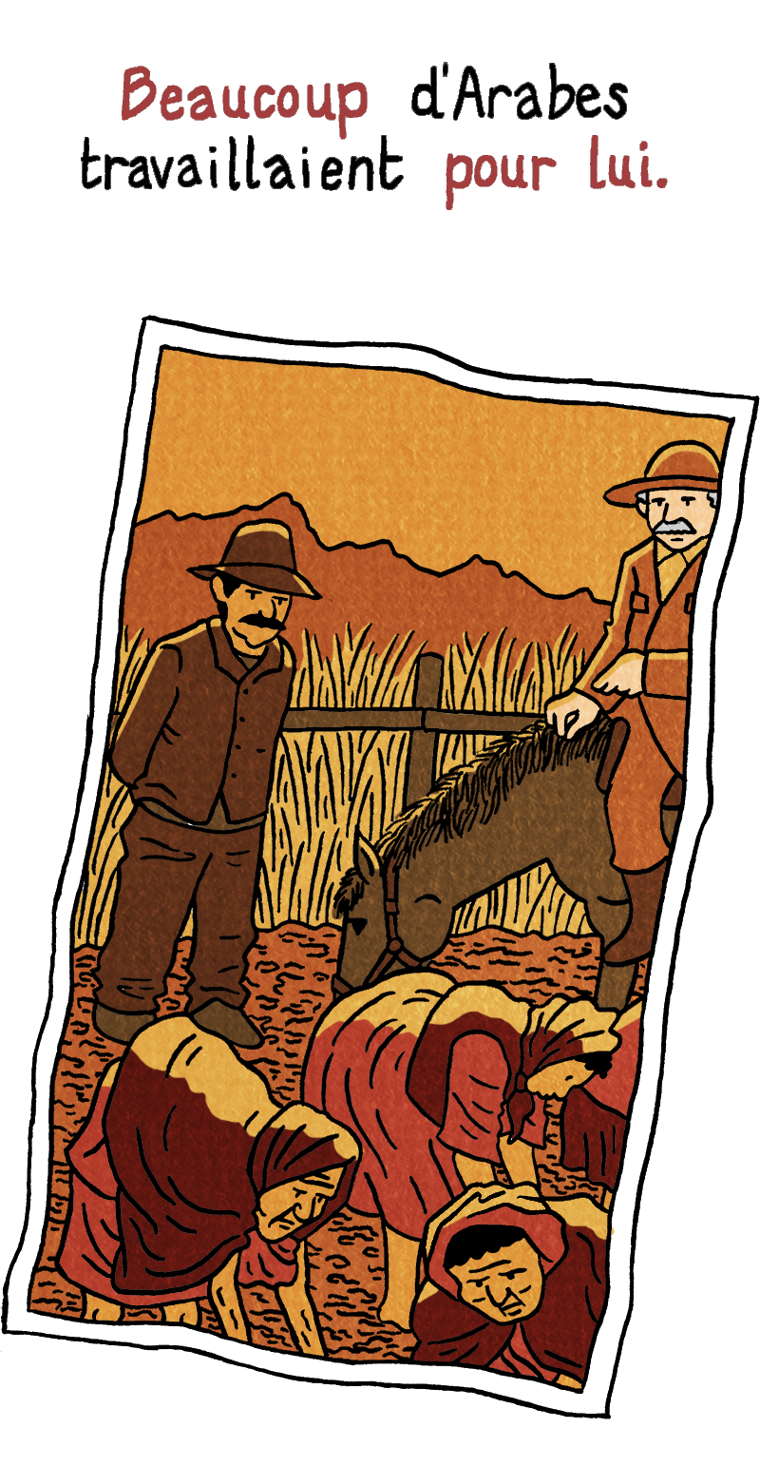
La Ferme
Let’s read the next section!
Read from 'Plus tard' (Later) to
'ils étaient très pauvres' (they were very poor).
Jeanne’s great-grandfather has moved to Algeria with his family. Local Arabs worked for him on his farm.

Slide 15

Les Sentiments
Activity 2a:
Using your French emoji chart on your activity sheet, pick the emoji responses for each question:
1. How do you think Jeanne’s great-grandfather felt about leaving France?
2. How do you think Jeanne’s grandfather felt about being given farmland in Algeria?
3. How would you feel?

Slide 16
La Ferme
Why do you think the local Arab people fought the French army when it arrived in Algeria?
Read the next section to help you, from 'ma mère dit qu'avant' (my mother says that before...) to
'Peut-être qu'ils n'étaient pas contents après tout' (Perhaps they weren't happy after all).

Slide 17
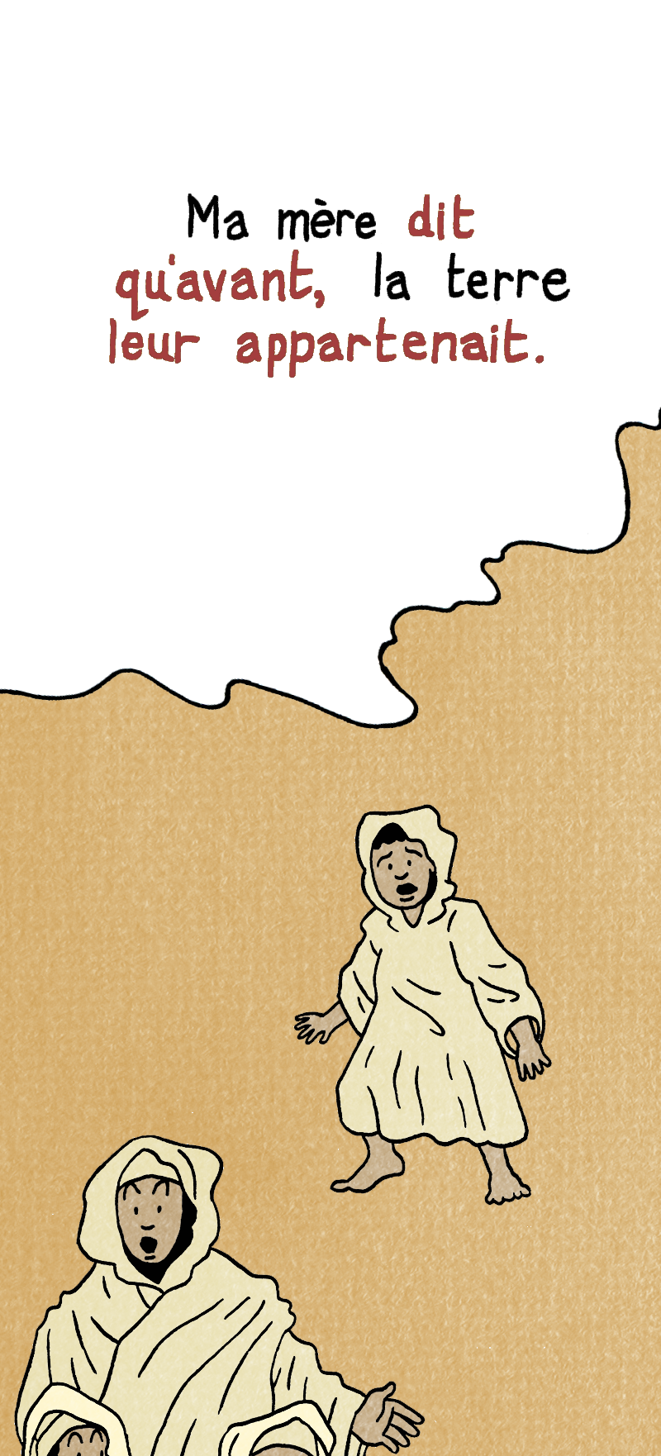
La Ferme
In this section we see that the land used to belong to the Arab people.
The French army took control of it and gave it to European settlers, like Jeanne’s family.

Slide 18
Les Sentiments
Activity 2b:
Using your French emoji chart, pick the emoji responses for each question:
1. How do you think the Arabs living in Algeria felt about the French coming?
2. How do you think local Arabs felt about working for Jeanne’s great-grandfather?

Slide 19
La Ferme
Do you think that what Jeanne’s great-grandfather remembers is different from what the Arab workers remember?
Can you see examples of this in this section?
Why would the Arab workers have a different view of things?

Slide 20
Two Empires: Britain and France
Jeanne’s great-grandfather left France for a new life in Algeria.
Like France, Britain also had an empire and many people from parts of Britain, especially Scotland and Ireland, left to start a new life in countries that belonged to Britain. Often, they were forced to leave.
What reasons might force them to leave?

Slide 21
How do we view emigrants and settlers?
After the Highland Clearances in Scotland, and the invasion of France by Germany, many people were forced to leave their homes.
We think of them as victims of history, fleeing poverty and war. We also see them as brave pioneers, building farms and making a new nation.
But there is another side to this.
Think about the Arabs and how they felt about the French arriving in Algeria. How do you think the native Americans and Australian aborigines felt about the arrival of British settlers?

