Slide 1
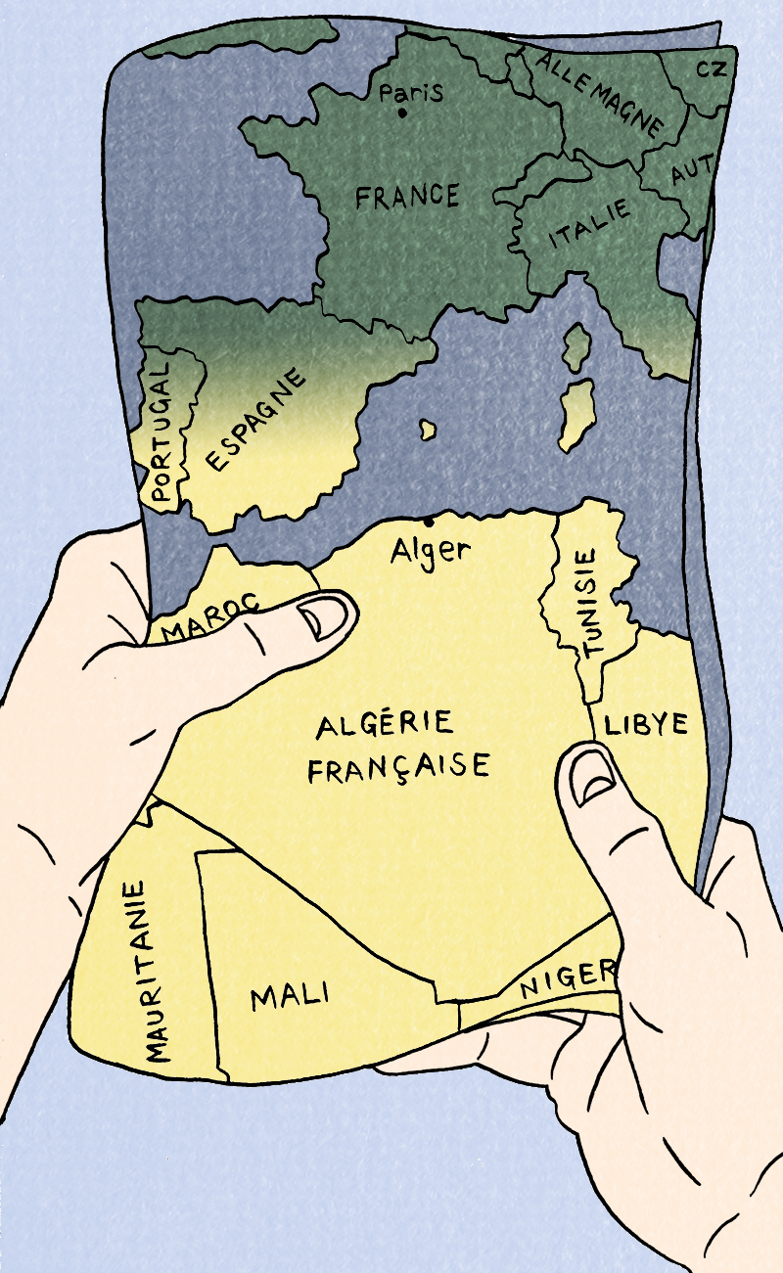
Session I

Slide 2
Today's language points
Countries and place names
• Common objects
• Asking and answering simple questions

Slide 3
Today's content
Discover our comic book
Read today’s section (from the beginning until 'Ma famille habite ici depuis des années' (my family has lived here for years)
Focus on character Jeanne and her family’s upcoming departure from Algeria to France. They have to leave home to find safety.
Discuss this session's themes: Emigration and Exile

Slide 4
Themes
Today’s themes are Emigration and Exile
Q. Do you know what these words mean?

Slide 5
Emigration and exile
Emigration refers to people leaving their home country and travelling to settle permanently in a different country. People choose to emigrate, although they may do so to escape poverty and seek a better life.
Exile refers to people who are forced to leave their home country, often because of war or political persecution. They don’t have a choice and often they are unable ever to return to their homes.

Slide 6
Do you have family in other parts of the world? Who and where?

Slide 7
Entre ici et là-bas
We are going to read a comic book together.
It tells the story of a young girl called Jeanne and her family in Algeria before they move to France.
Jeanne’s family are French but they emigrated to Algeria a long time ago, in the nineteenth century.

Slide 8
Entre ici et là-bas
Task: Let’s read our first section!
Start at the beginning and read until 'On va en France bientôt' (We're going to France soon).

Slide 9
Entre ici et là-bas
Discuss as a class:
What are Jeanne and her family waiting for?
Do you think they are going on holiday? Do they seem happy to go?
Is it like this when you travel? What is the same? What is different?

Slide 10
Entre ici et là-bas
In this story, we follow Jeanne’s family as they move from Algeria to France in 1962.
This isn’t like a holiday or a nice move that they have looked forward to. They are leaving because they are afraid of staying in Algeria.
We will learn why in the next sections...

Slide 11
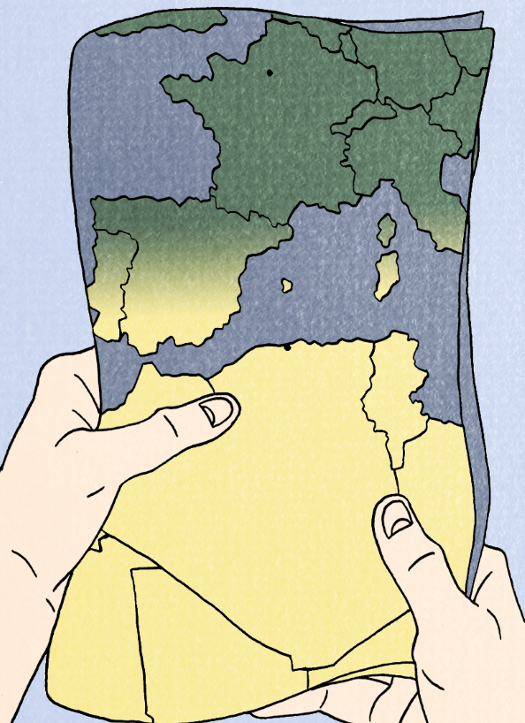
Carte de la région
Activity 1: Fill in the correct French place names from the box on the map on your activity sheet.
You will not need to use all of the names – there are some red herrings!
Algérie Espagne Allemagne Irlande Madrid
France Italie Tunisie Alger Mauritanie
Maroc Libye Paris Portugal Écosse
Grèce Rome la Mer Atlantique
la Mer Méditerranée

Slide 12
Carte de la région
Discuss:
Now look at your completed map. Compare your answers with a partner.
Now think:
Where do you come from? Where do your parents come from? And your grandparents?
If anyone in your family has emigrated, what would this have been like for them? How did the people in the new country react to their arrival?

Slide 13
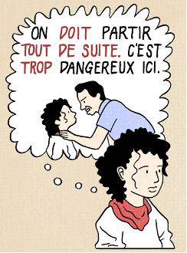
Carte de la région
In our comic, we follow the movement of one family across countries over several generations.
These moves have been hard and are a result of difficult circumstances, including conflict.
Reminder: What country are they coming from? Where are they going? Why?

Slide 14
Entre ici et là-bas
Task: Let’s read our second and third sections!
Read until 'Ma famille habite ici depuis des années' (My family has lived here for years).
Vocabulary: Valise = suitcase

Slide 15
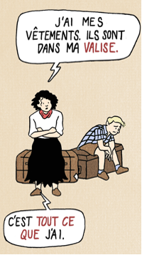
La valise de Jeanne
As we see in the comic, Jeanne and her family need to pack their valises very quickly to leave the country. They don’t have time or space to pack everything.
Activity 2a: What’s in my valise?
The teacher will call out the items in their valise in French. See how many you can identify! They will take the item out to show you only when you correctly identify it!

Slide 16
La valise de Jeanne
Q. What things is Jeanne unable to pack that she may miss from her life in Algeria?
Some of these are mentioned, and some you can imagine (e.g. her friends)

Slide 17
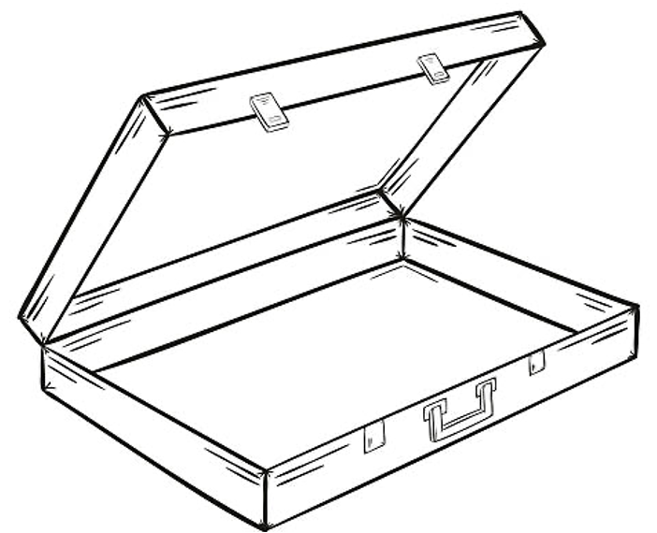
Qu’est-ce que tu mets dans ta valise?
Activity 2b: What’s in your valise?
What would you put in your suitcase? Jeanne had to pack her suitcase very quickly when they had to leave Algeria. If you were in that situation, what would you pack?
Fill the suitcase in your activity pack with pictures and label them in French. Be prepared to explain why you’ve chosen each of the items!

Slide 18
Discuss: Do people still have to leave their homes with no warning today?

Slide 19
Should we do anything in response? If so, what?

